Slide 1
Setting up a website on Cloud Course - AWS SysOps Administrator
By – Nilesh Shardul
Email – Nileshbshardul@gmail.com

Slide 2
DESCRIPTION
You are a Cloud engineer. Your company has brought in a new client who has got a website. However, they need a web server so that they can run their website completely on Cloud. Once the web server is up and running, they want you to configure the Cloud so that testing of the web server can be completed successfully.

Slide 3
MAJOR STEPS
Create an EC2 instance (OS: Windows 2012 R2 Base)
Install IIS server role
Create a static website and check on a localhost
Create an image of the machine and save the AMI
Create a new instance using the AMI you have saved
Create a Load Balancer and attach the instances you have done before
Check the DNS name on the browser

Slide 4
Create an EC2 instance
(OS: Windows 2012 R2 Base)
Note: All configuration selected as per free tier available

Slide 5
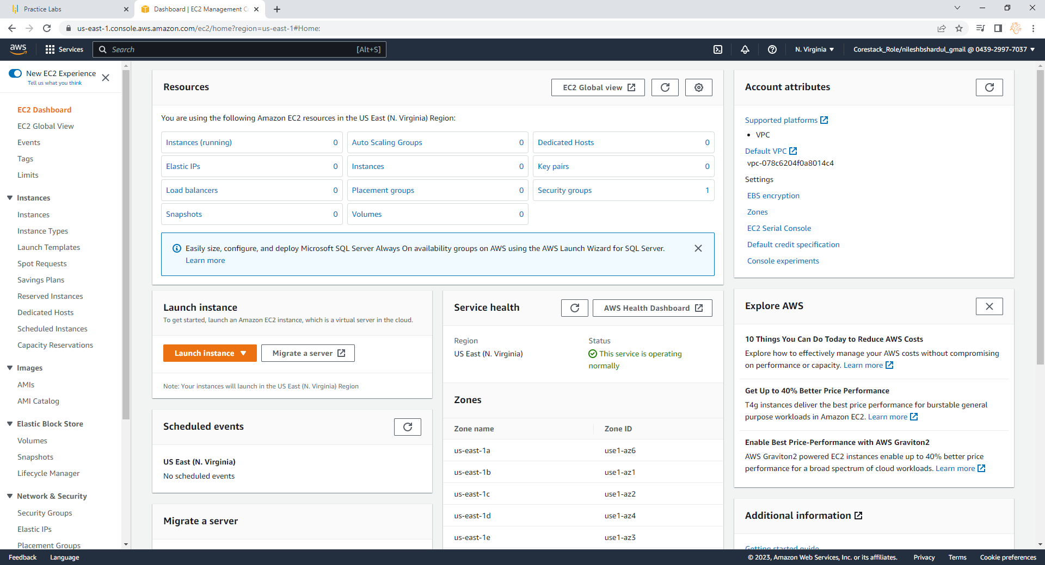
Step 1: Go o EC2 service after login to AWS console and click on Launch instance button

Slide 6
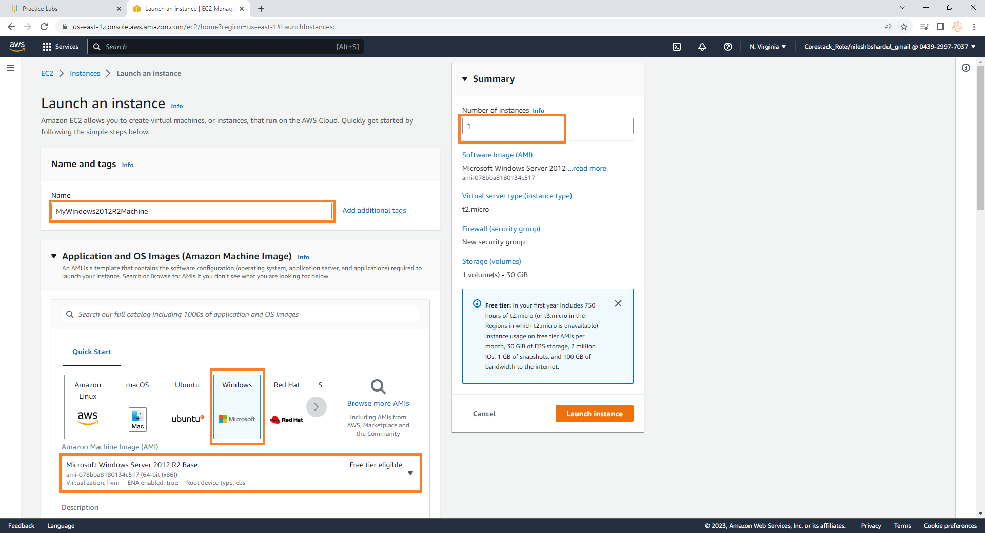
Step 2: Give instance name like MyWindows2012R2Machine. Select Widows in AMI section and then select AMI Microsoft Windows Server 2012 R2 Base. Keep Number of instances to 1 in Summary section

Slide 7
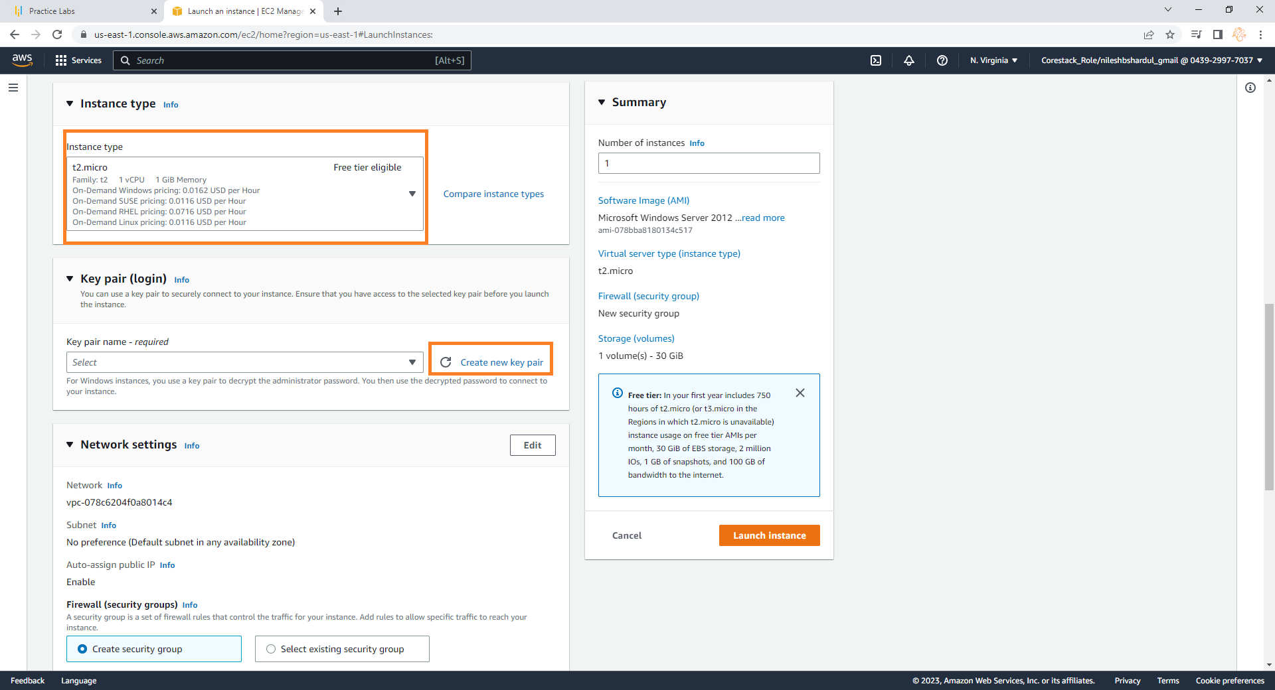
Step 3: Select instance type t2.micro and click on Create new key pair in Key pair(login) section (you can use existing key pair if you have it already)

Slide 8
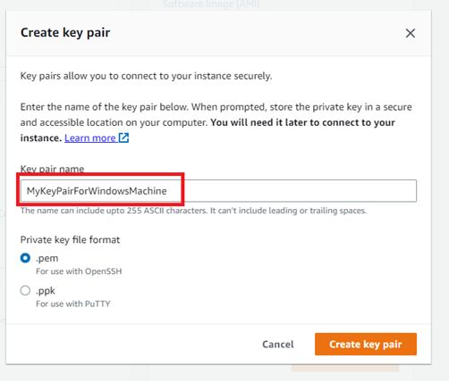
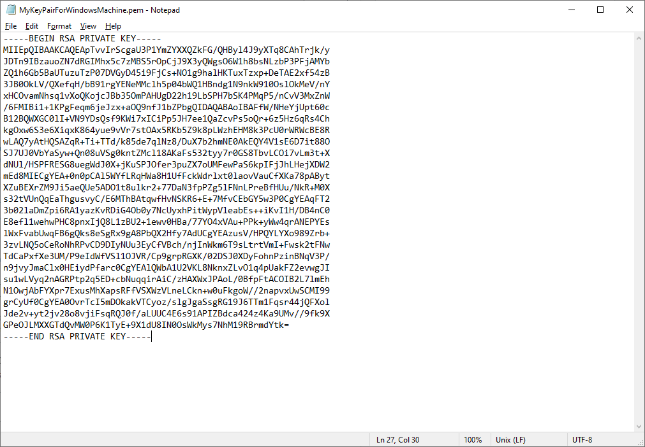
Step 4: Give meaningful name to key pair like - MyKeyPairForWindowsMachine, keep file format to .pem and click on Create key pair button. Once the key pair downloaded, open the file using notepad. This will be a private key (screenshot shown on the right below)

Slide 9
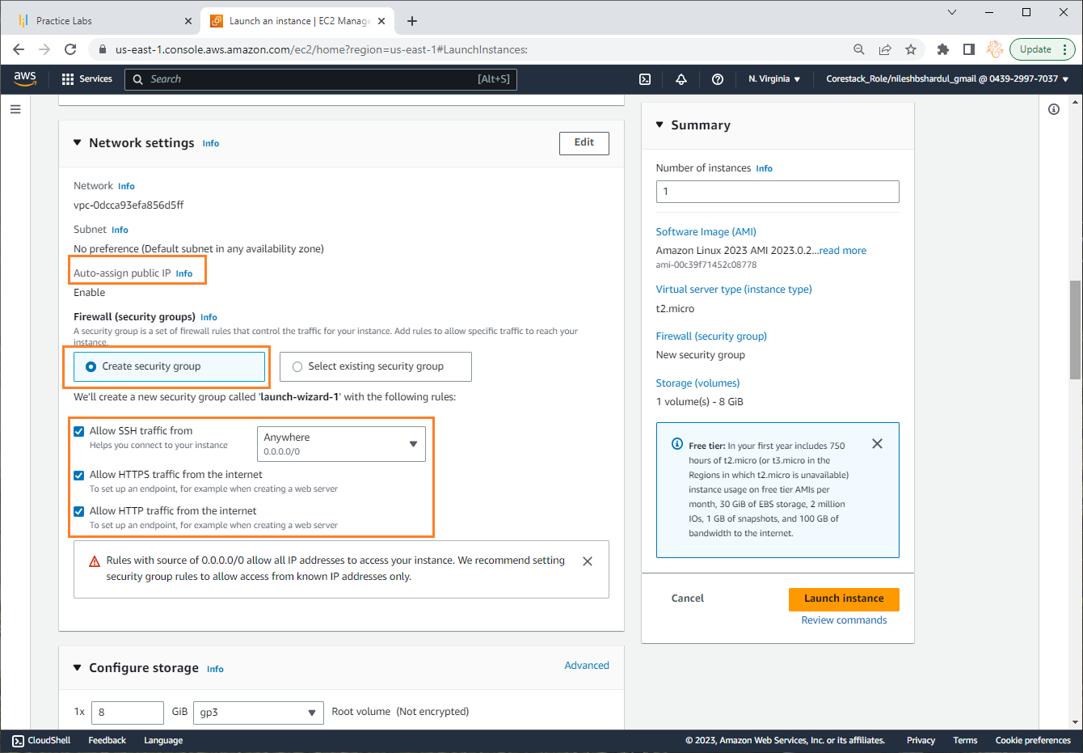
Step 5:

Slide 10
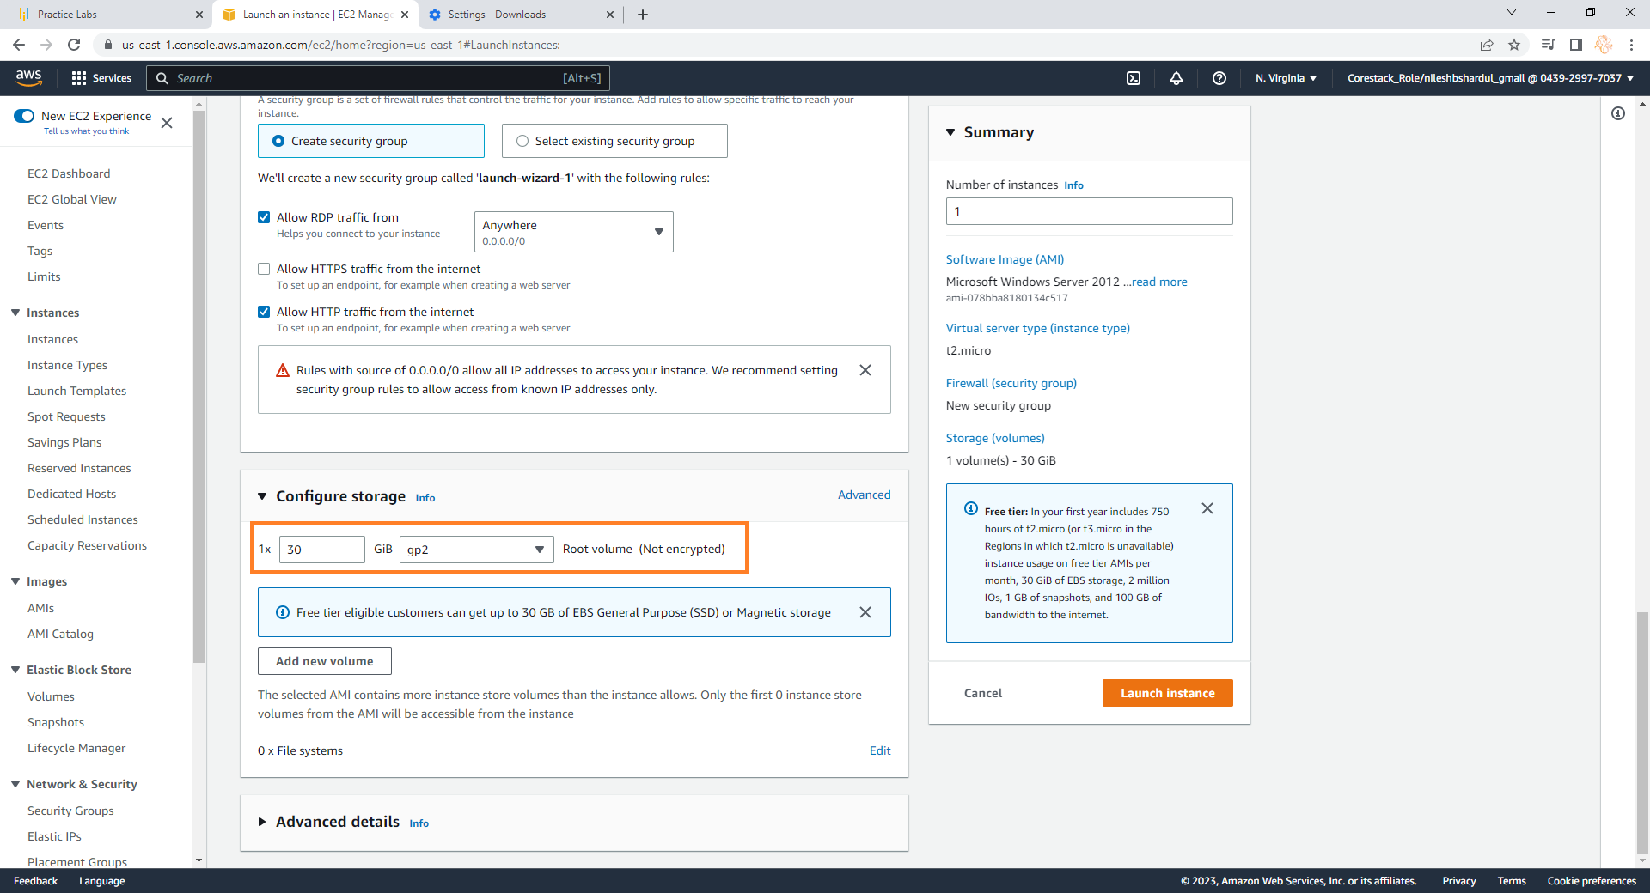
Step 6: Keep the default settings in Configure storage. Here you can add/modify volumes if you want. Click on Launch Instance button on the right

Slide 11
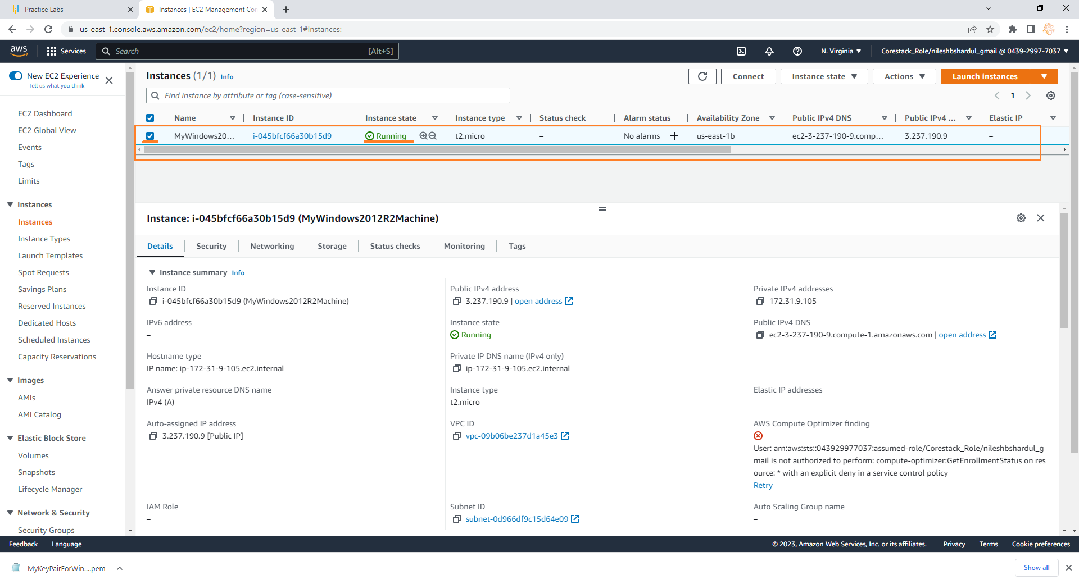
Step 7: Go to EC2 instances and wait until the instance state is Running. If you click on the instance you will see all the details below

Slide 12
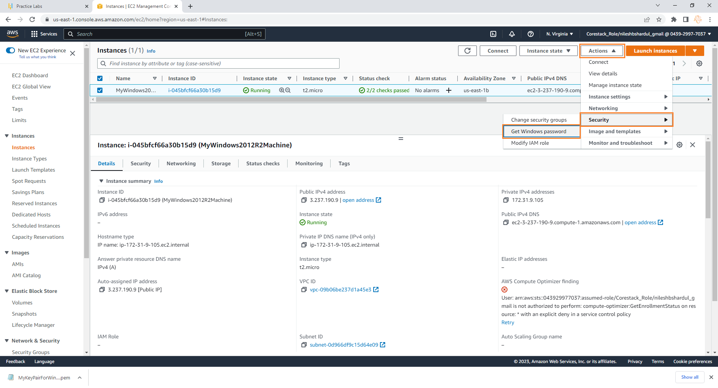
Step 8: Now to connect to this machine click on Actions > Security > Get Windows password as shown below

Slide 13
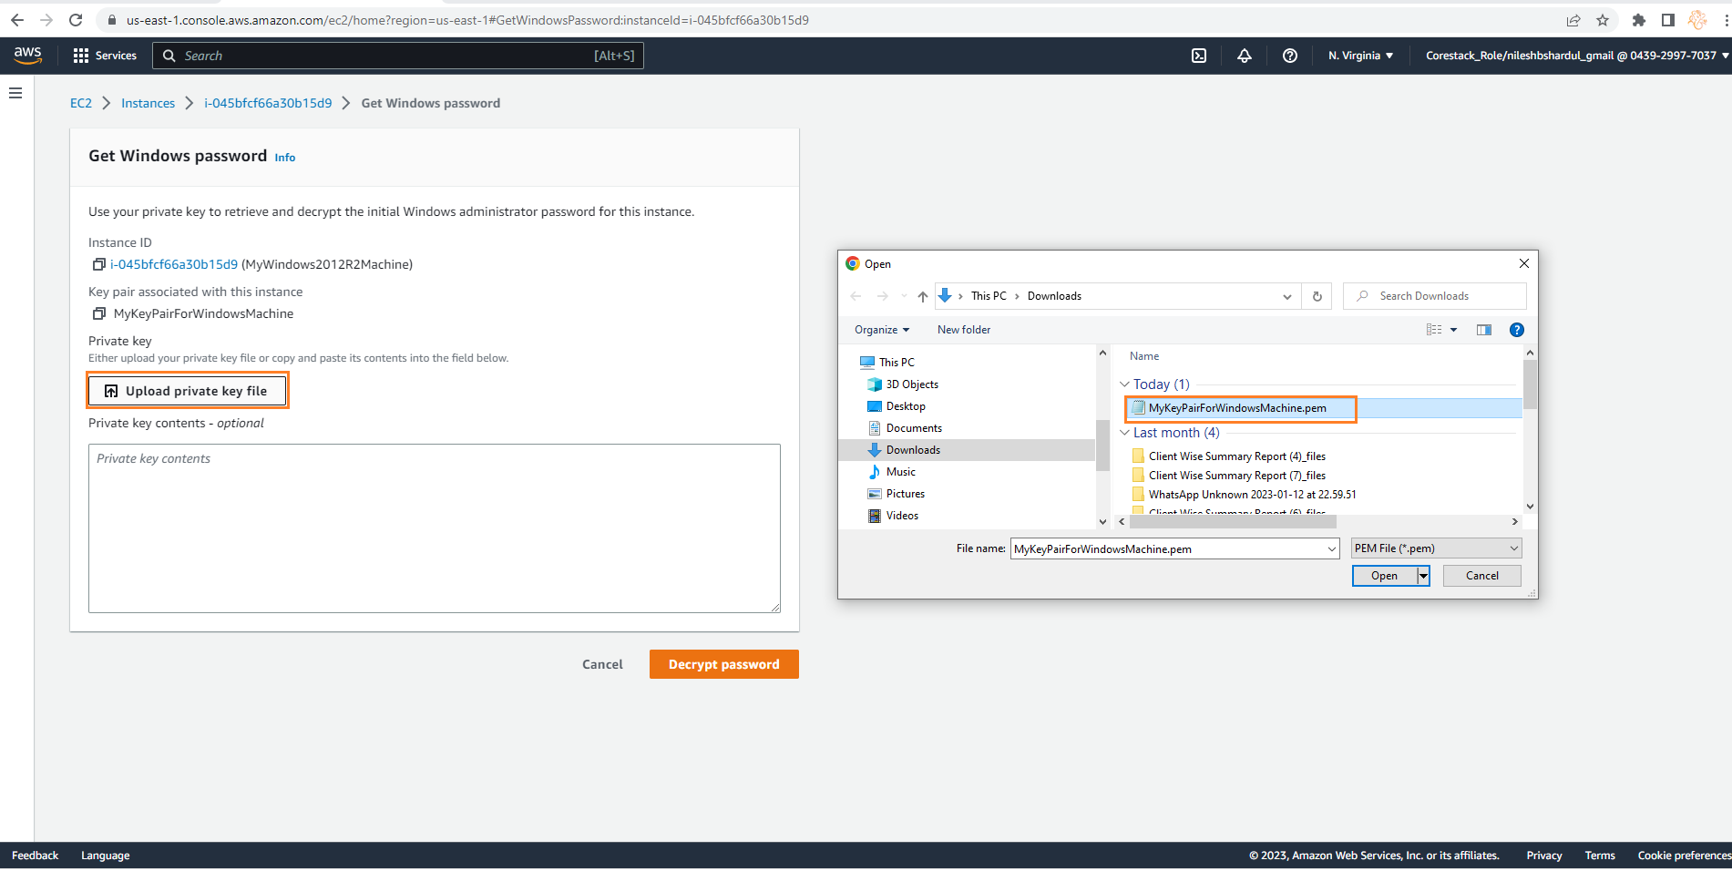
Step 9: Now to connect to this machine click on Actions > Security > Get Windows password as shown below

Slide 14
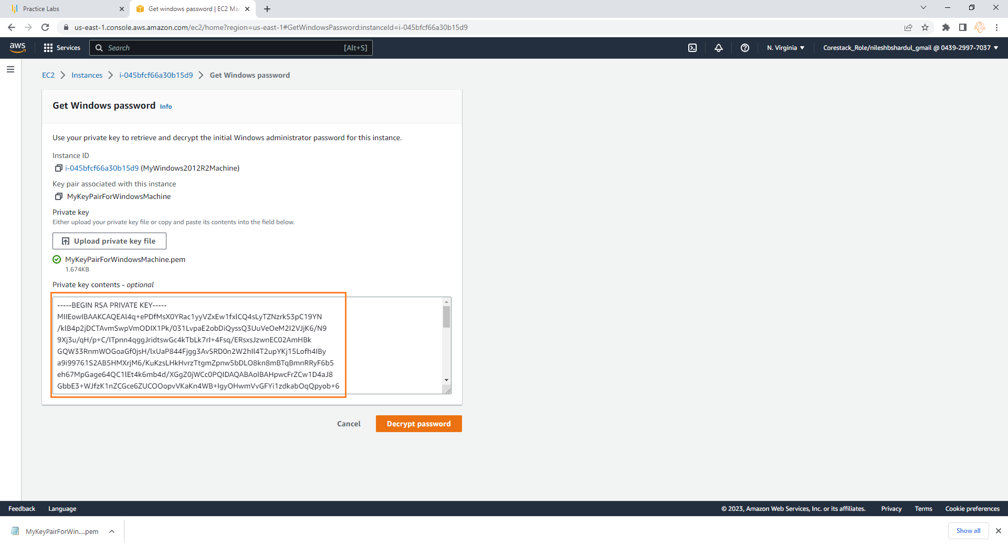
Step 10: You can see the private key in Private key content section after selecting the file. Now click on Decrypt password button

Slide 15
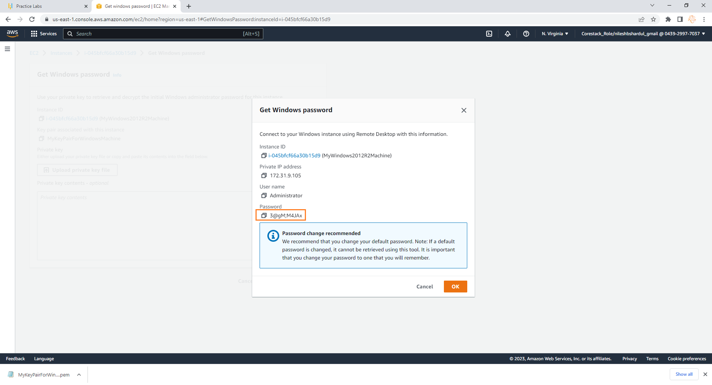
Step 11: You can see the decrypted password below. Copy the password, keep it at secured place and go back to EC2 instances.

Slide 16
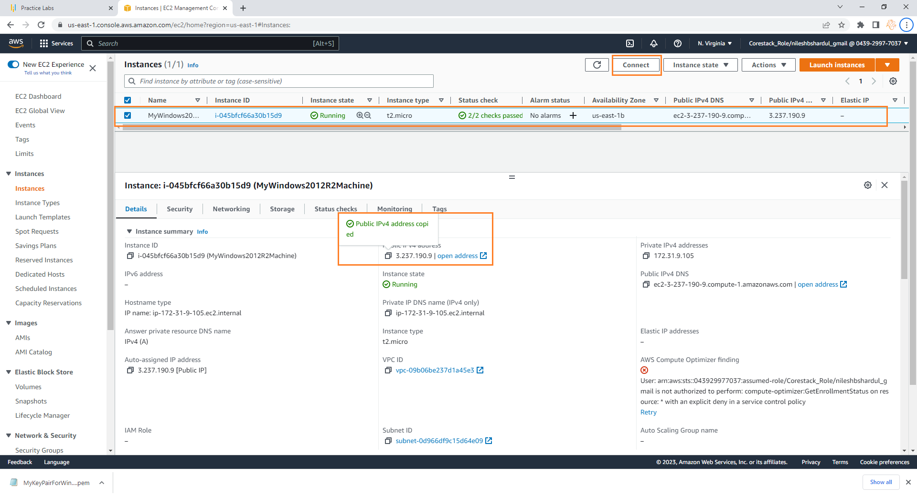
Step 12: Now copy the public IP for the new instance as shown below, keep it in some file and click on Connect button

Slide 17
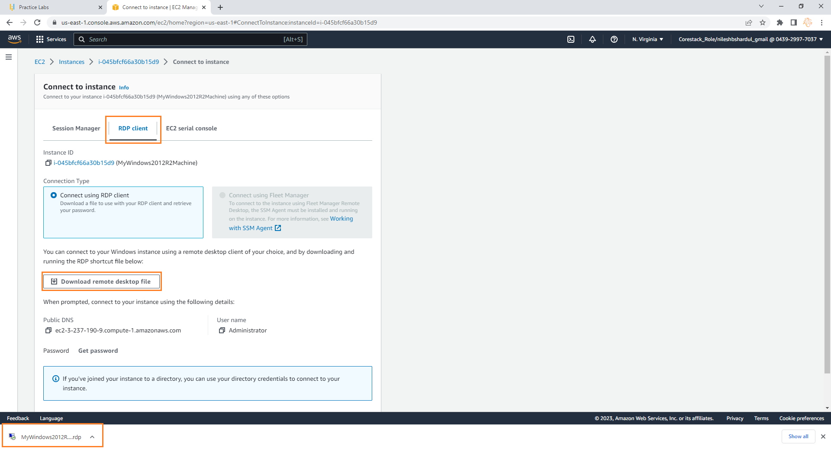
Step 13: Click on RDP client tab, select option connect using RDP client and download RDP by clicking Download remote desktop file. Click and open the downloaded file so RDP program will start where you can provide credentials for login

Slide 18
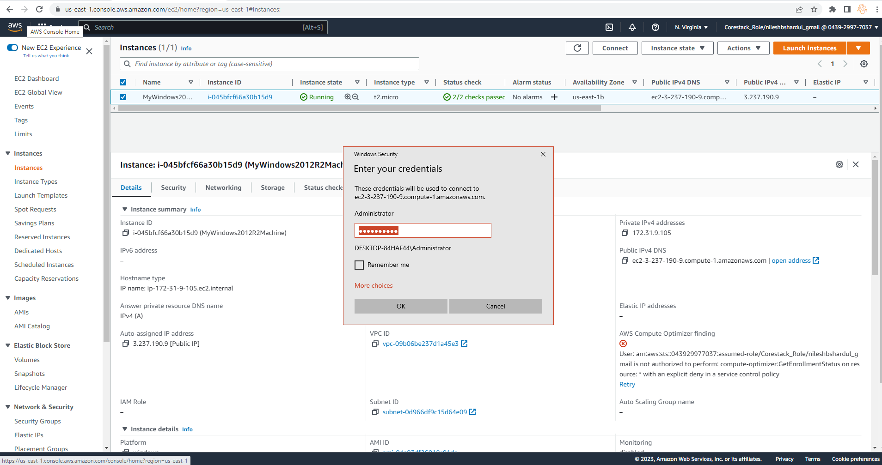
Step 13: Enter the password which is extracted from Step 11 to login to EC2 instance

Slide 19
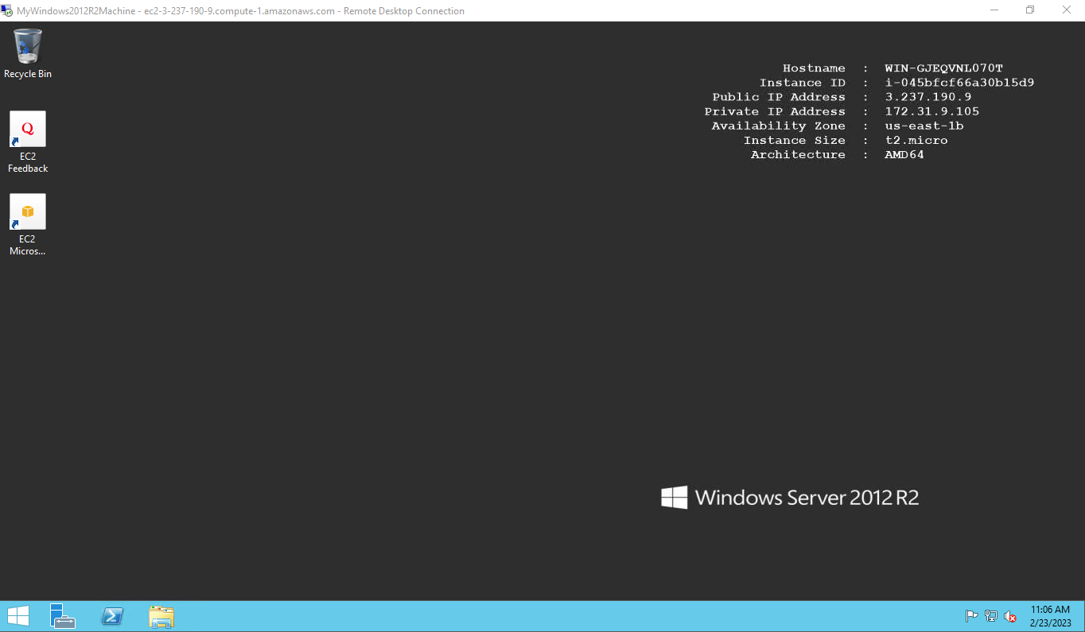
Step 14: After entering the credentials you will be able to see the desktop for the windows instance

Slide 20
Install IIS server role
Note: All configuration selected as per free tier available

Slide 21
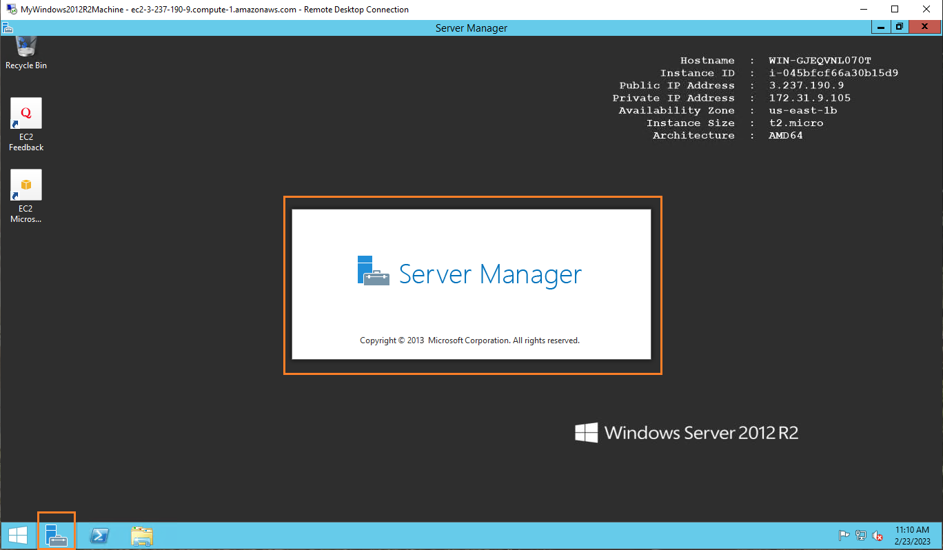
Step 1: Click on Server Manager icon next to windows icon in the below taskbar

Slide 22
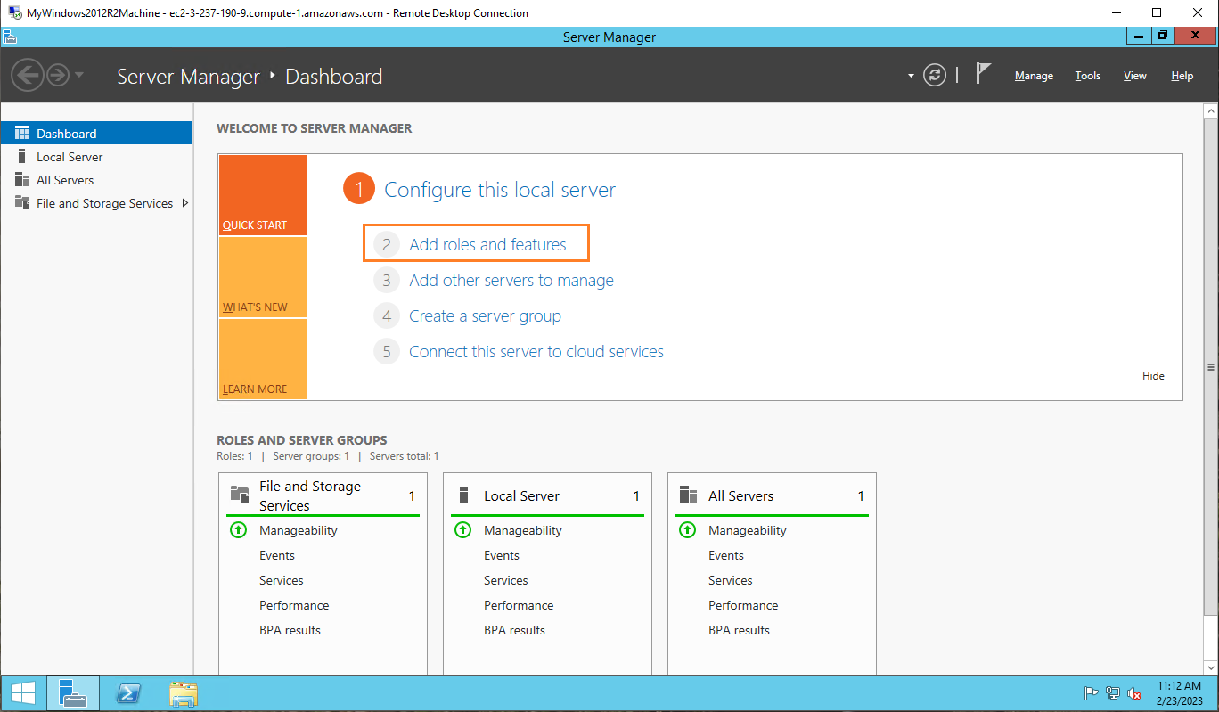
Step 2: Click on Add roles and features option

Slide 23
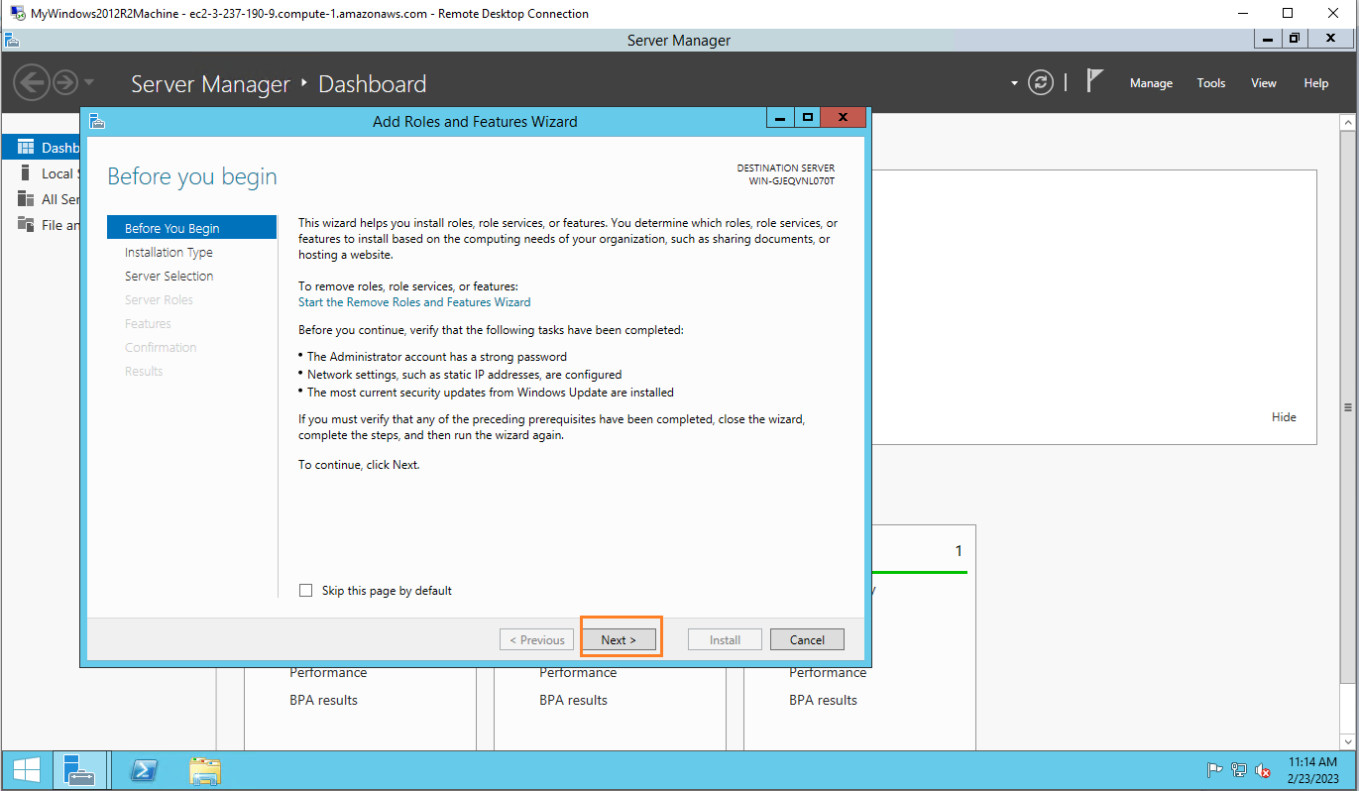
Step 3: Click on Next button

Slide 24
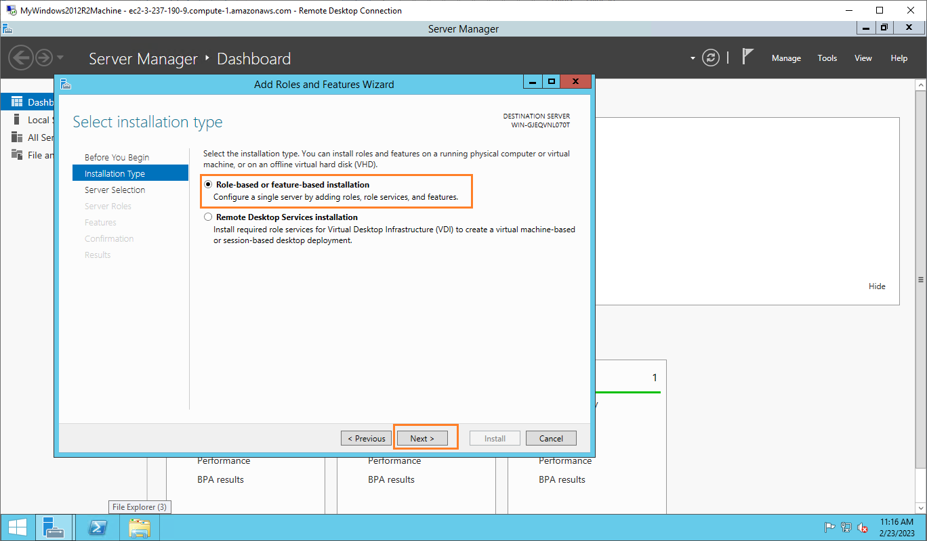
Step 4: Click on Role-based or feature-based installation and then Next button

Slide 25
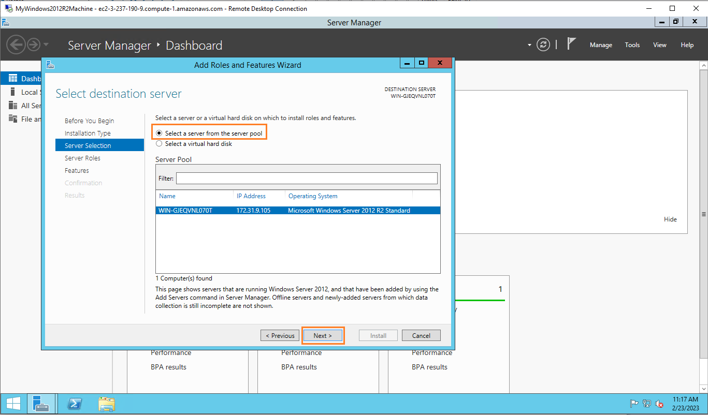
Step 5: Select a server from the server pool as shown below and click on Next

Slide 26
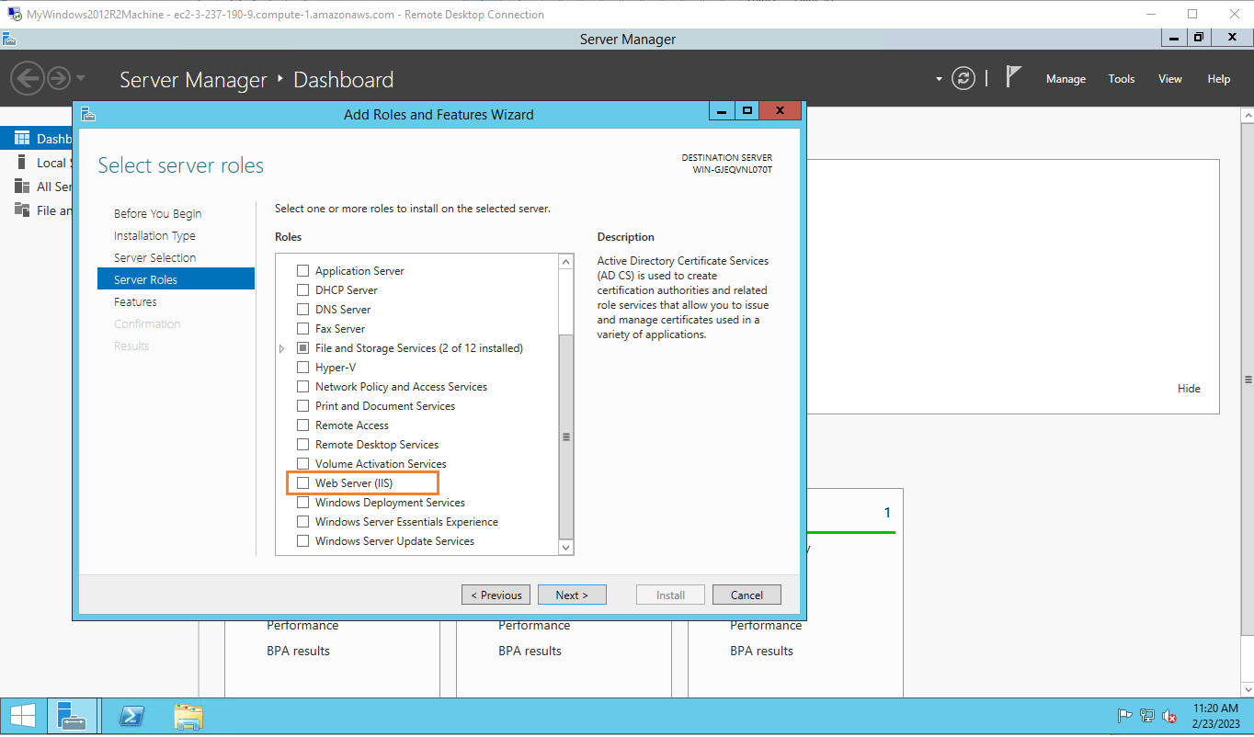
Step 6: select server role as Web Server(IIS)

Slide 27
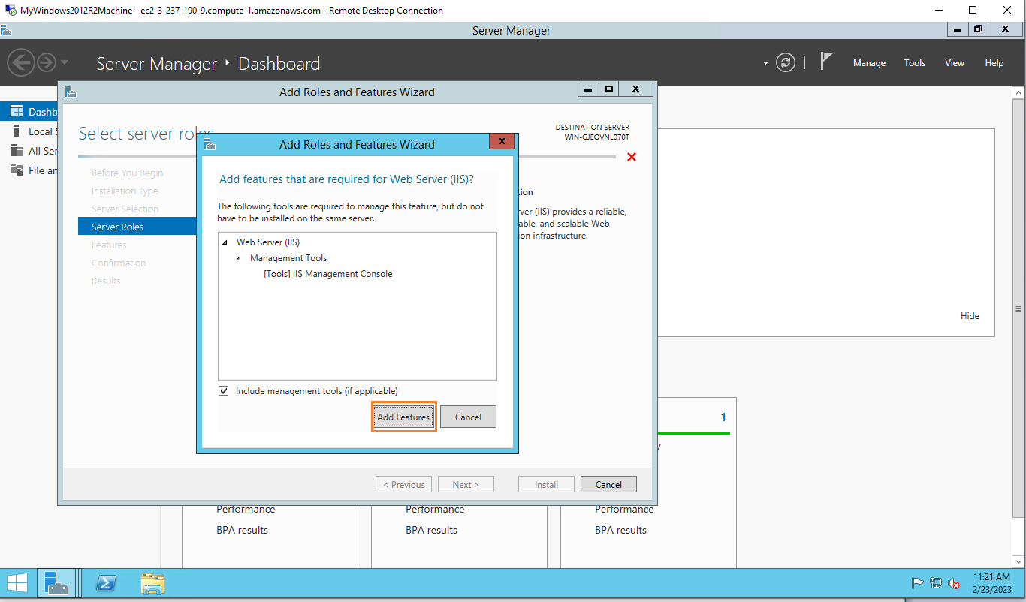
Step 7: Click on Add Features in Add Roles and Features Wizard

Slide 28
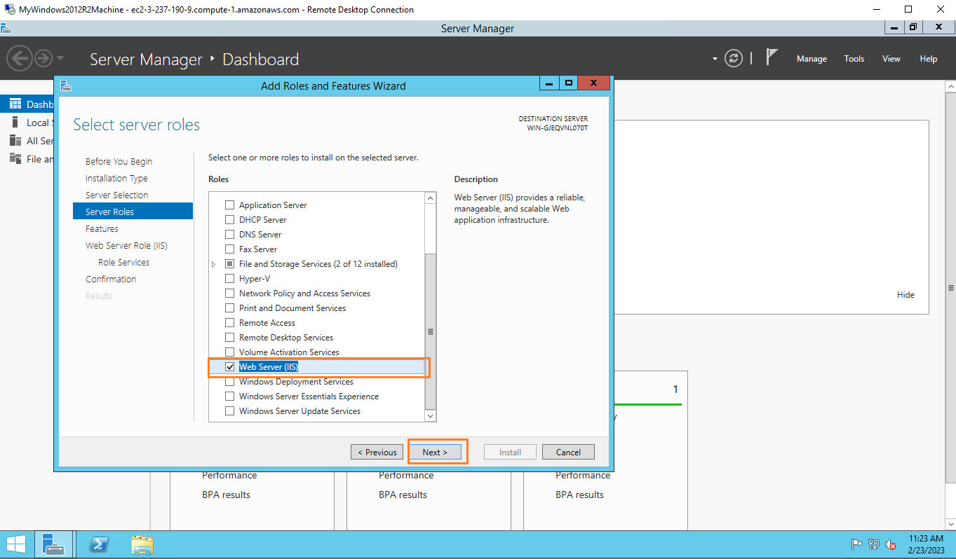
Step 8: Once Web Server(IIS) is selected, click on Next button

Slide 29
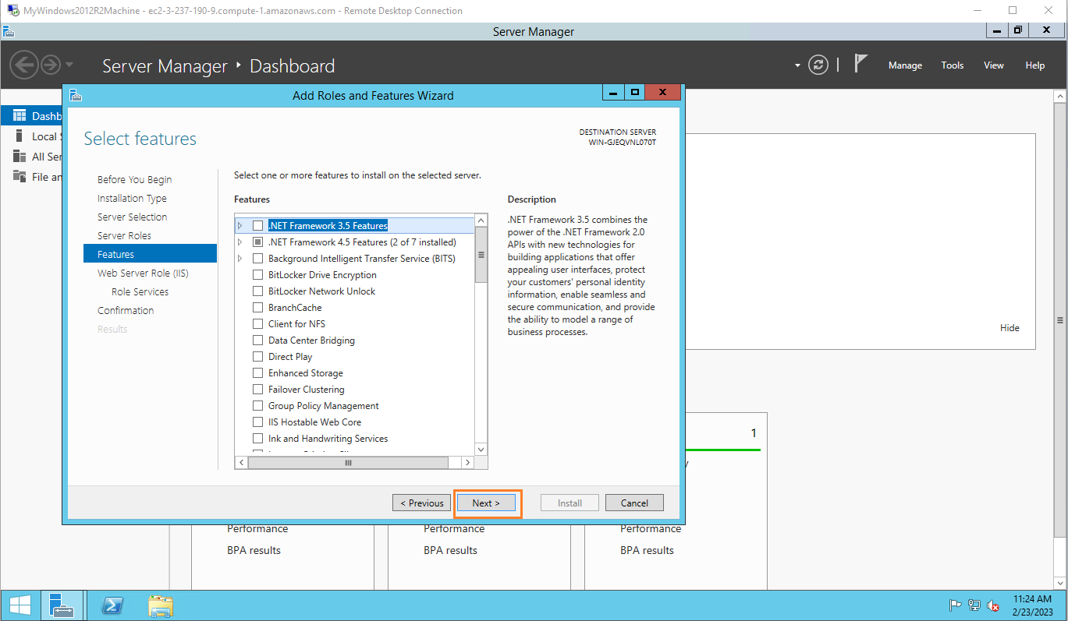
Step 9: Click on Next button in Features

Slide 30
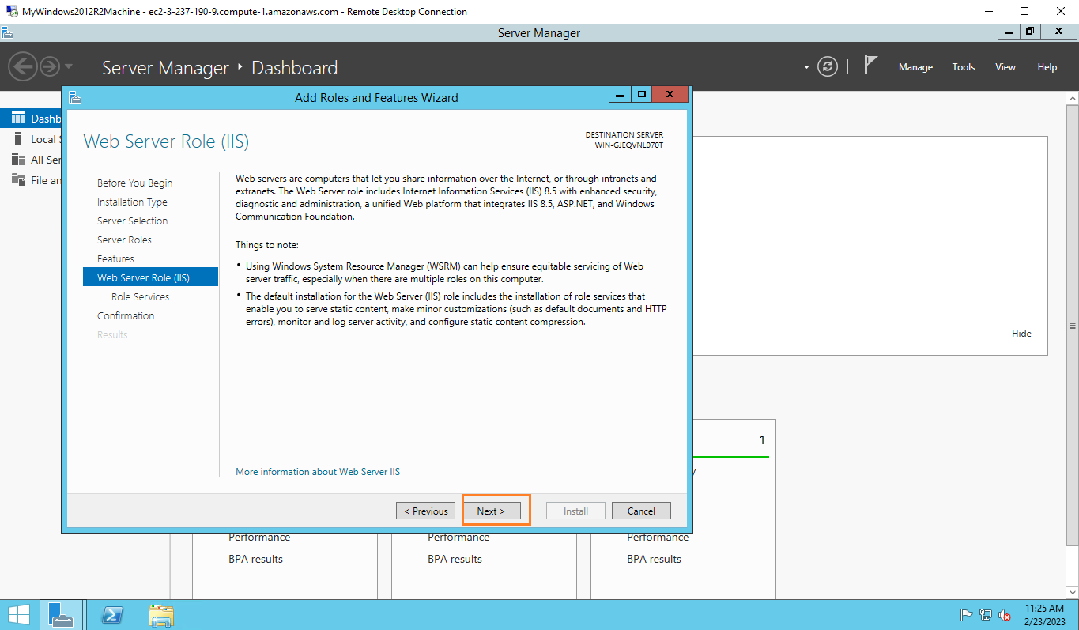
Step 10: Click on Next in Web Server Role (IIS)

Slide 31
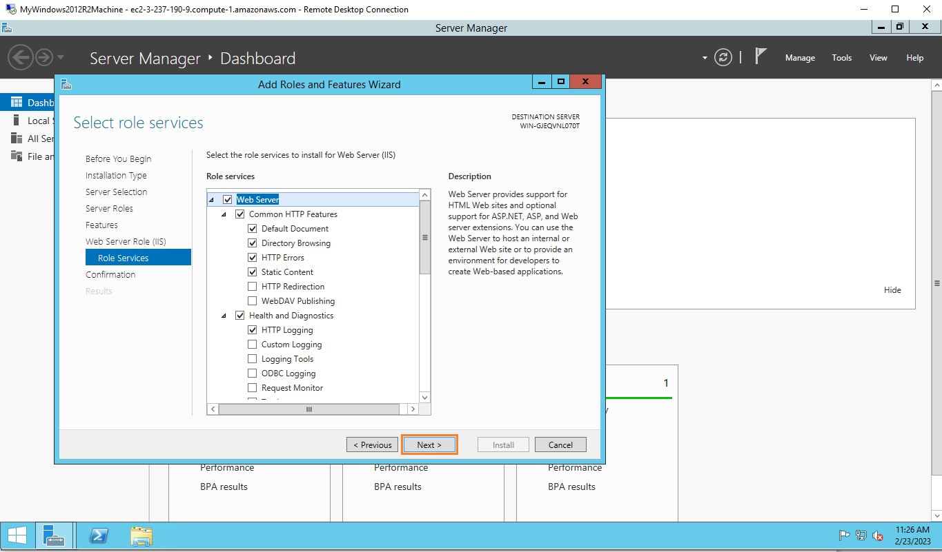
Step 11: Click on Next in Role Services

Slide 32
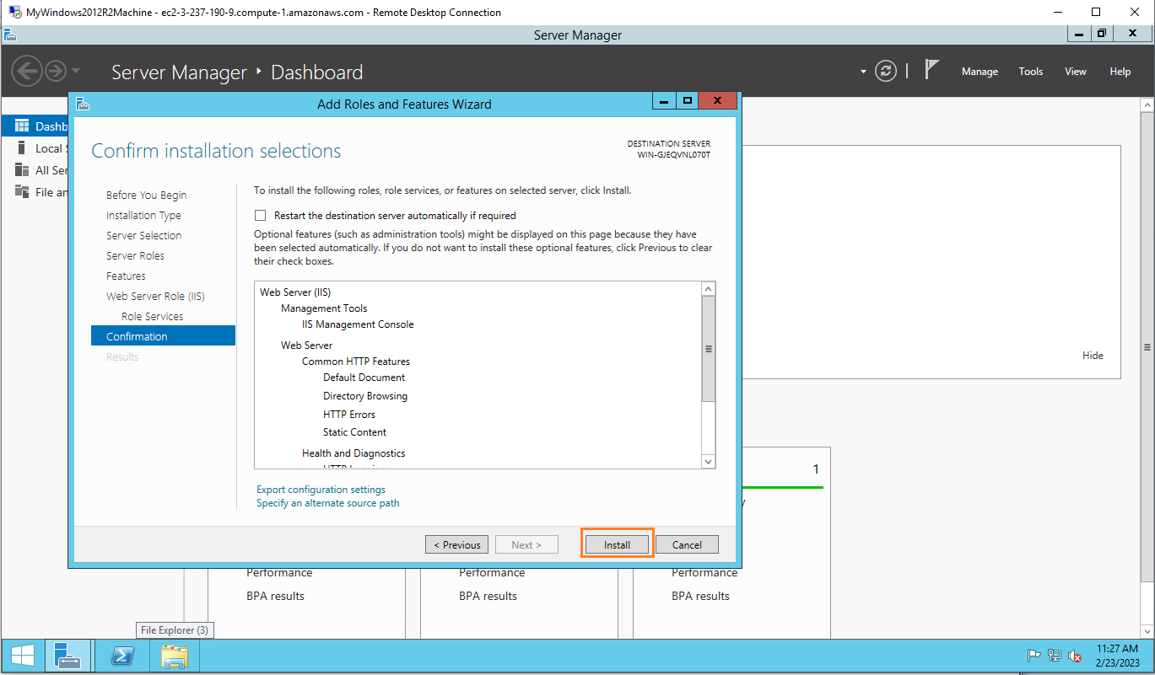
Step 11: Click on install button in Confirmation

Slide 33
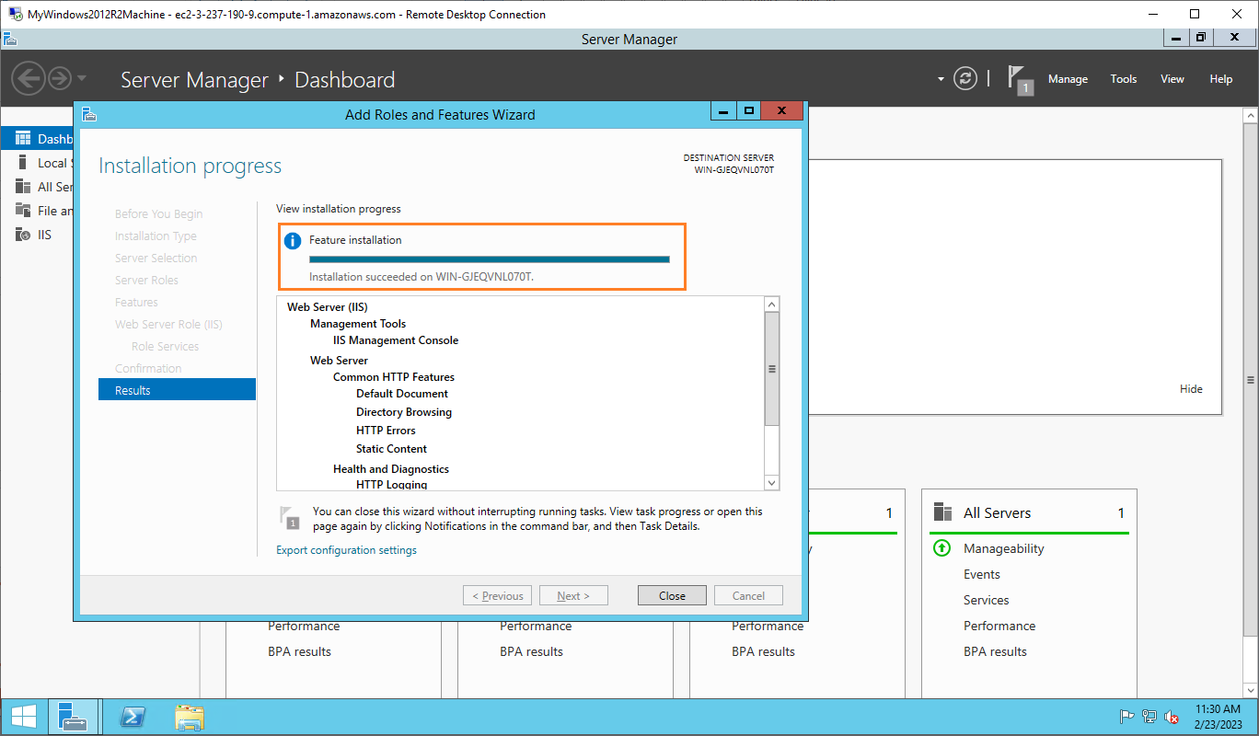
Step 12: Click on Close button once you see Installation succeeded

Slide 34
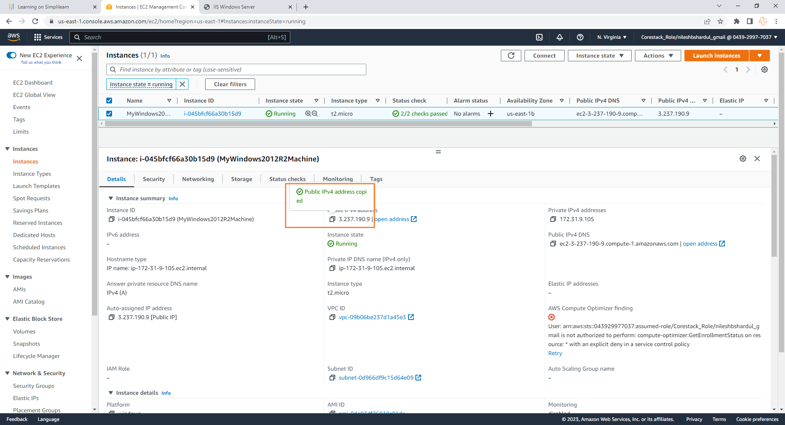
Step 13: Copy Public IP of instance and open IP in the address bar of new browser

Slide 35
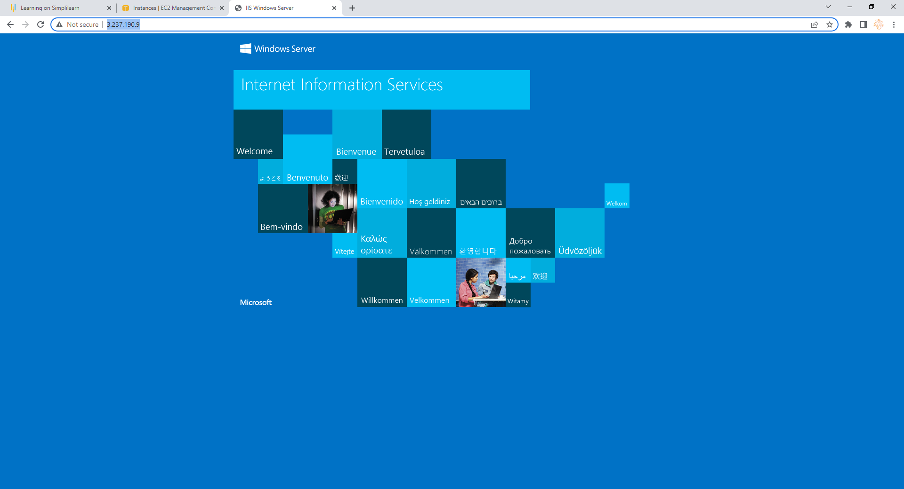
Step 14: You can see the IIS server default page opened in the browser as shown below. So here we are sure that IIS server is running on the machine

Slide 36
Create a static website and check on a localhost
Note: All configuration selected as per free tier available

Slide 37
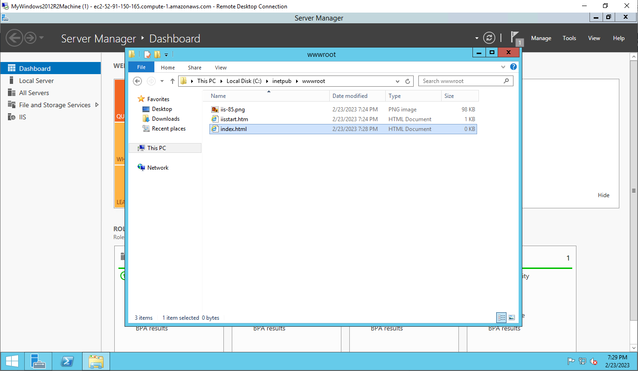
Step 1: In the new windows instance go to location C:\inetpub\wwwroot and create new file index.html here

Slide 38
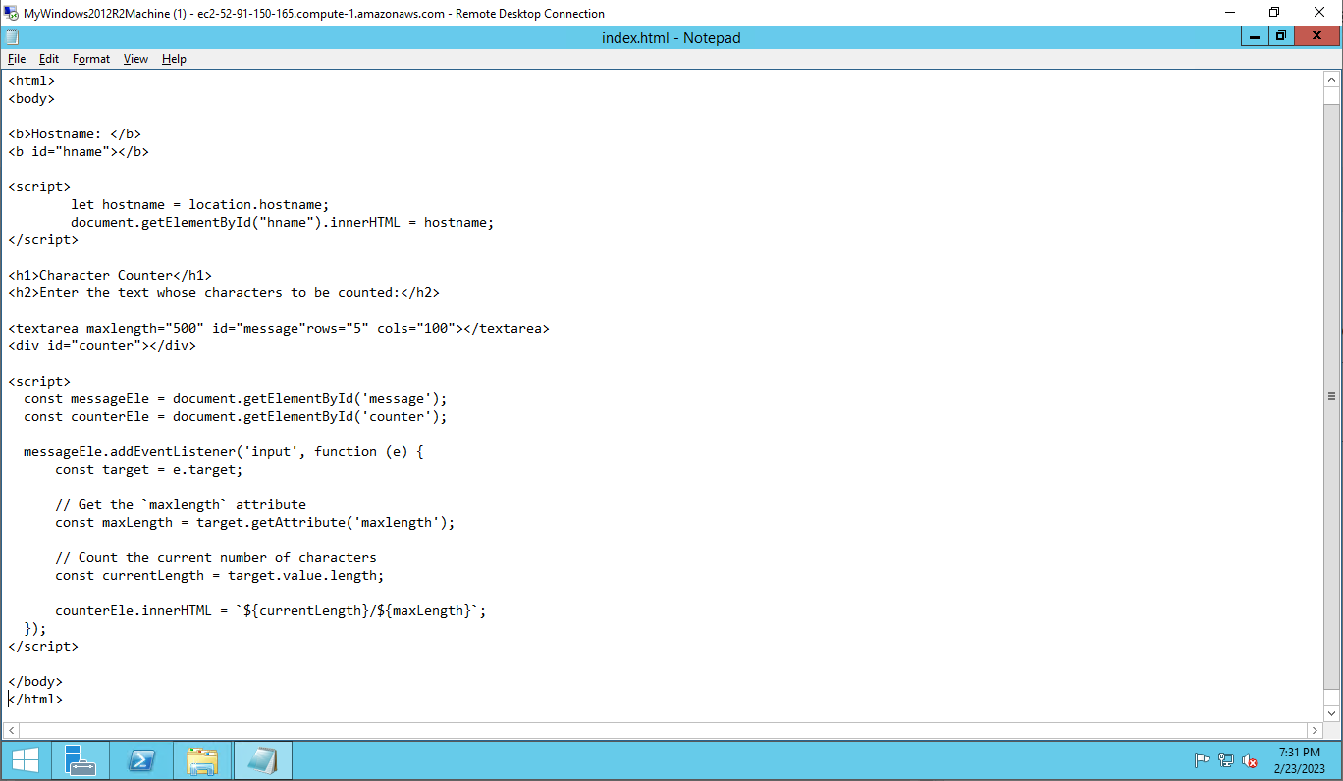
Step 2: Open index.html file and add following content. This is a simple web page which counts the number of characters entered by user in the textfield

Slide 39
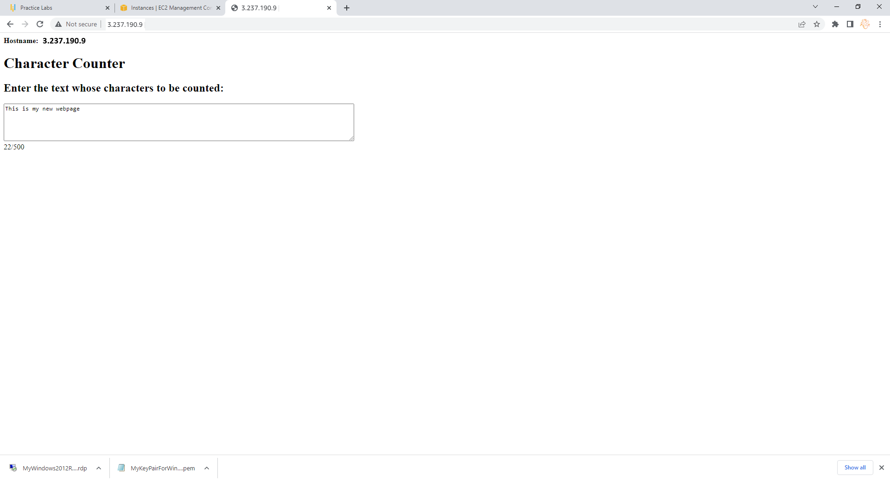
Step 3: Check the IP address again from localhost (your machine) browser.

Slide 40
Create an image of the machine and save the AMI
Note: All configuration selected as per free tier available

Slide 41
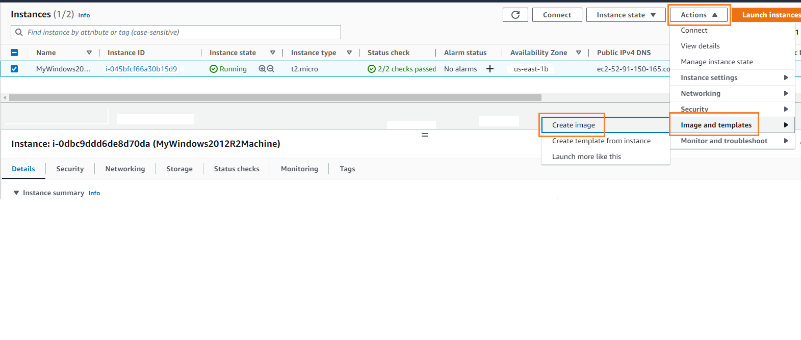
Step 1: To create an image first go to EC2 > instances. Click on Actions > Image and templates > create image

Slide 42
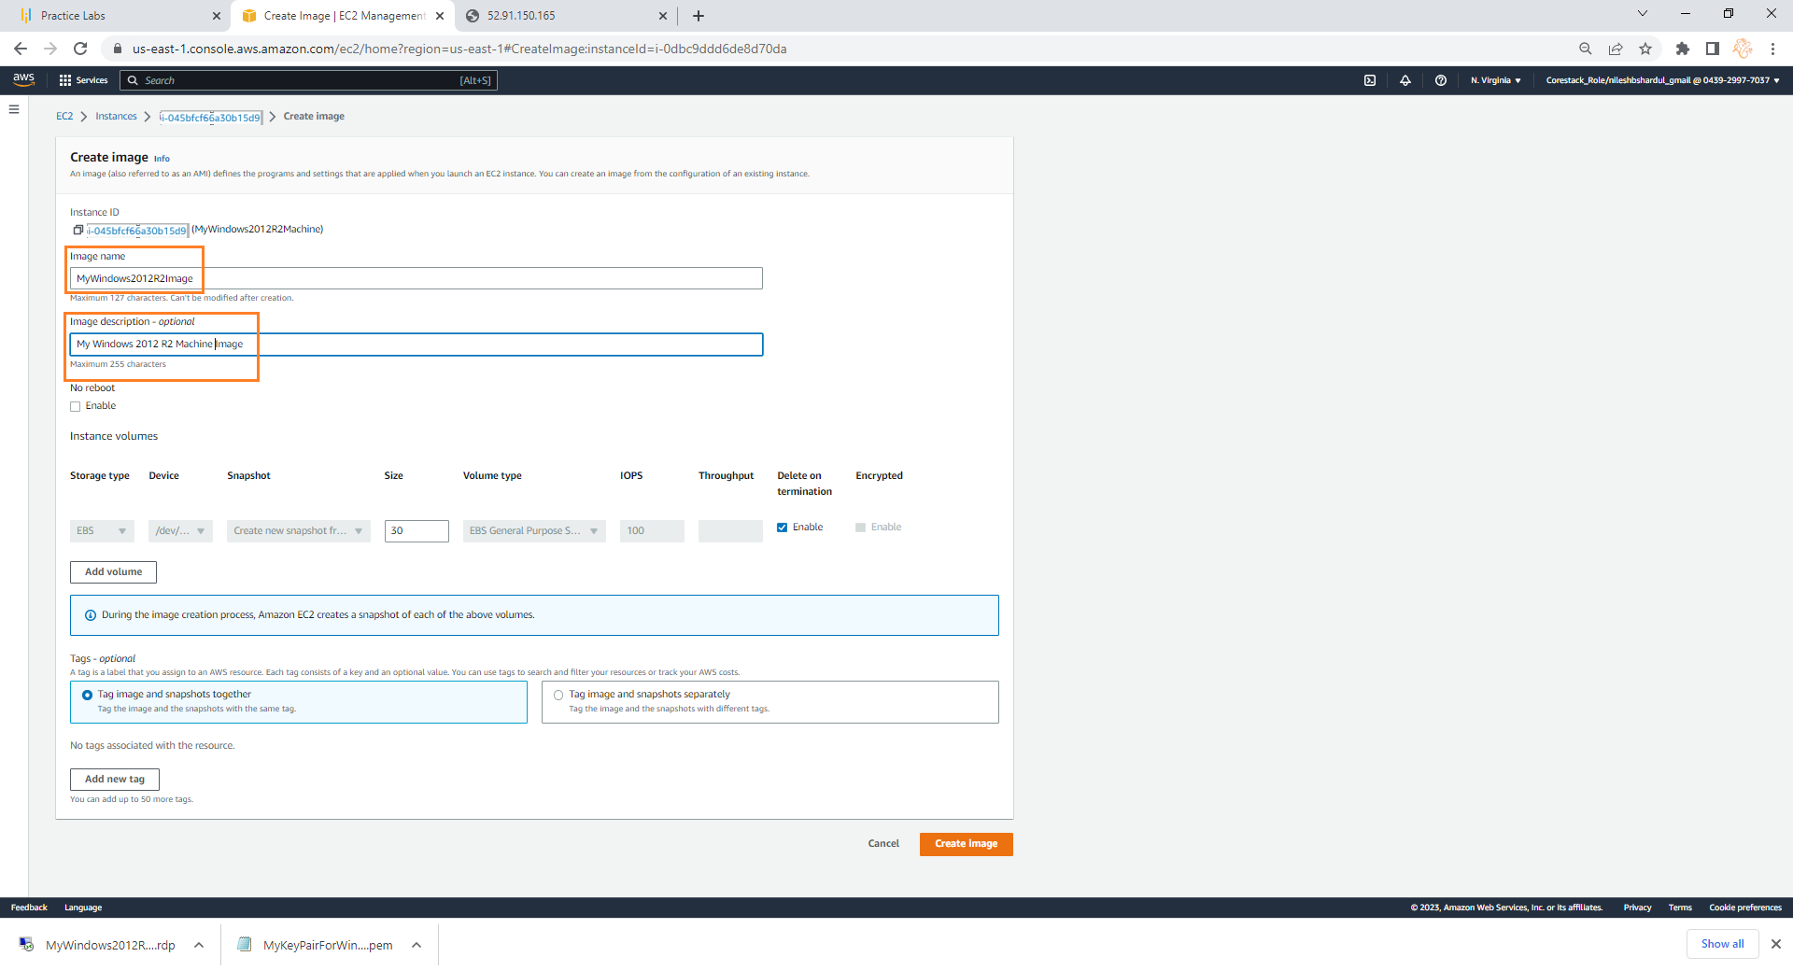
Step 2: Give Image name e.g. MyWindows2012R2Image, Description, keep other default settings and click on Create Image

Slide 43
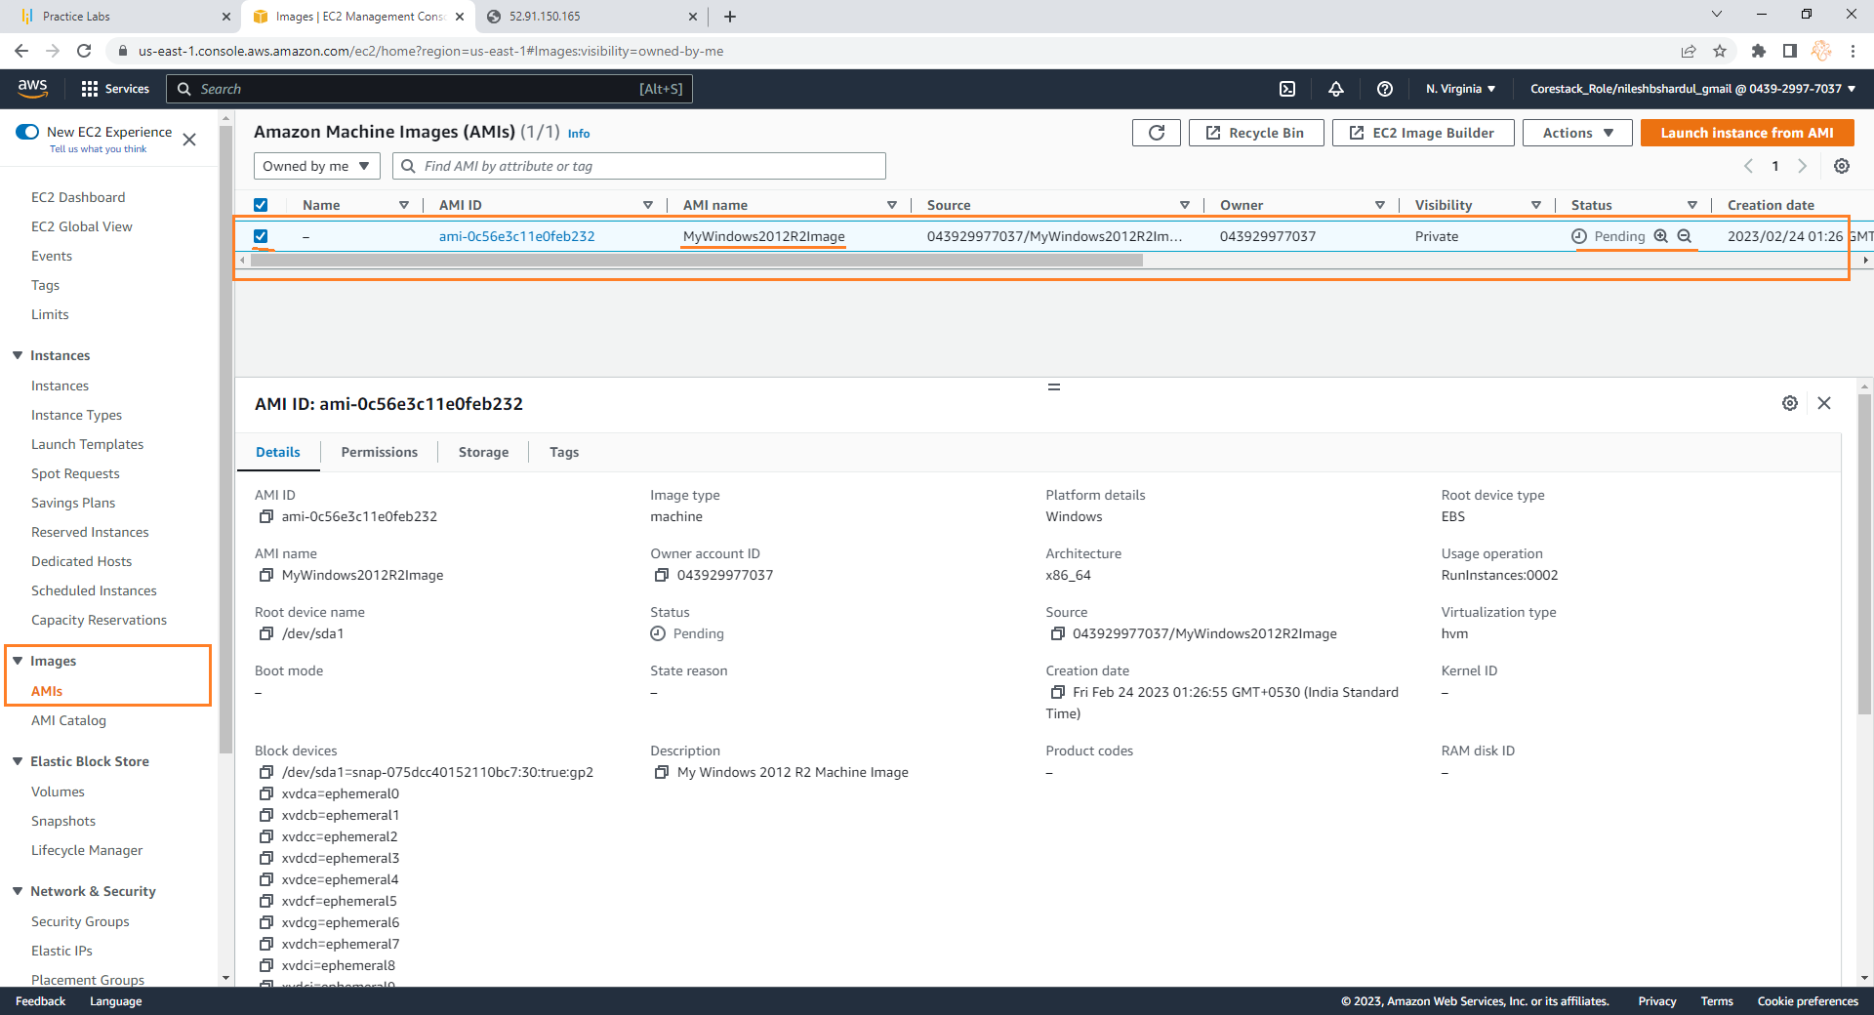
Step 3: Click on Images > AMI on the left menu under EC2, select the image created from the list on the right hand side, you can see the image details below

Slide 44
Create a new instance using the AMI you have saved
Note: All configuration selected as per free tier available

Slide 45
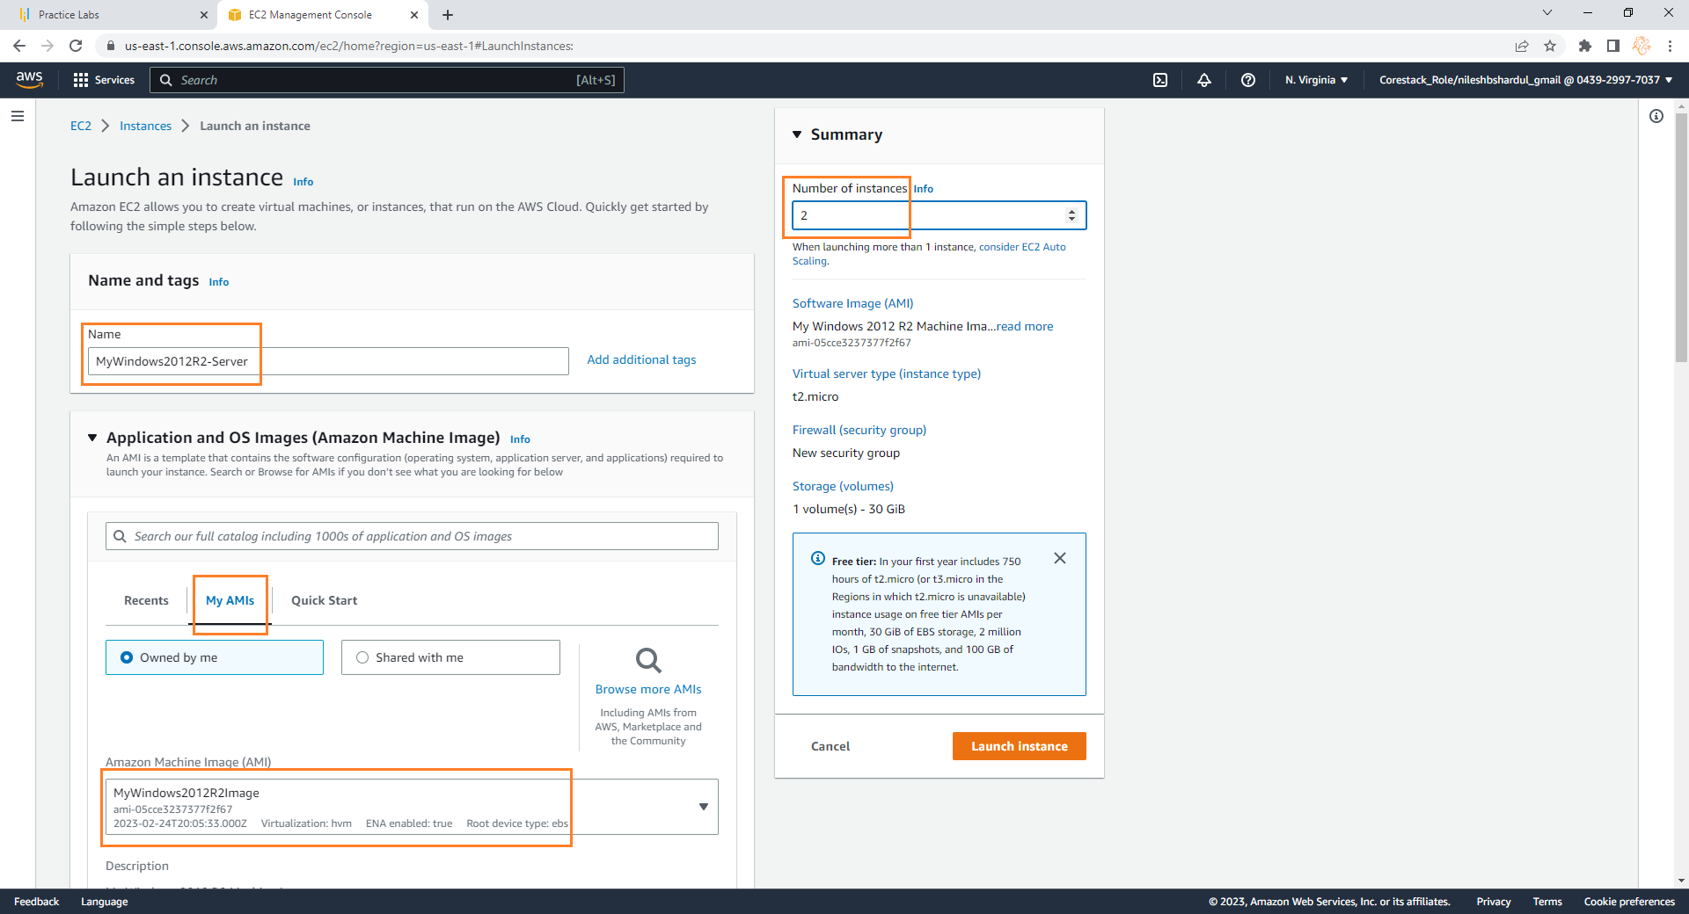
Step 1: Now create 2 new instances from the AMI created from the above steps. Go to EC2 > instances > Launch an instance. Give server name e.g. MyWindows2012R2-Server. Click on My AMIs tab, select option Owned by me and select the image MyWindows2012R2Image you have created in above steps as shown below

Slide 46
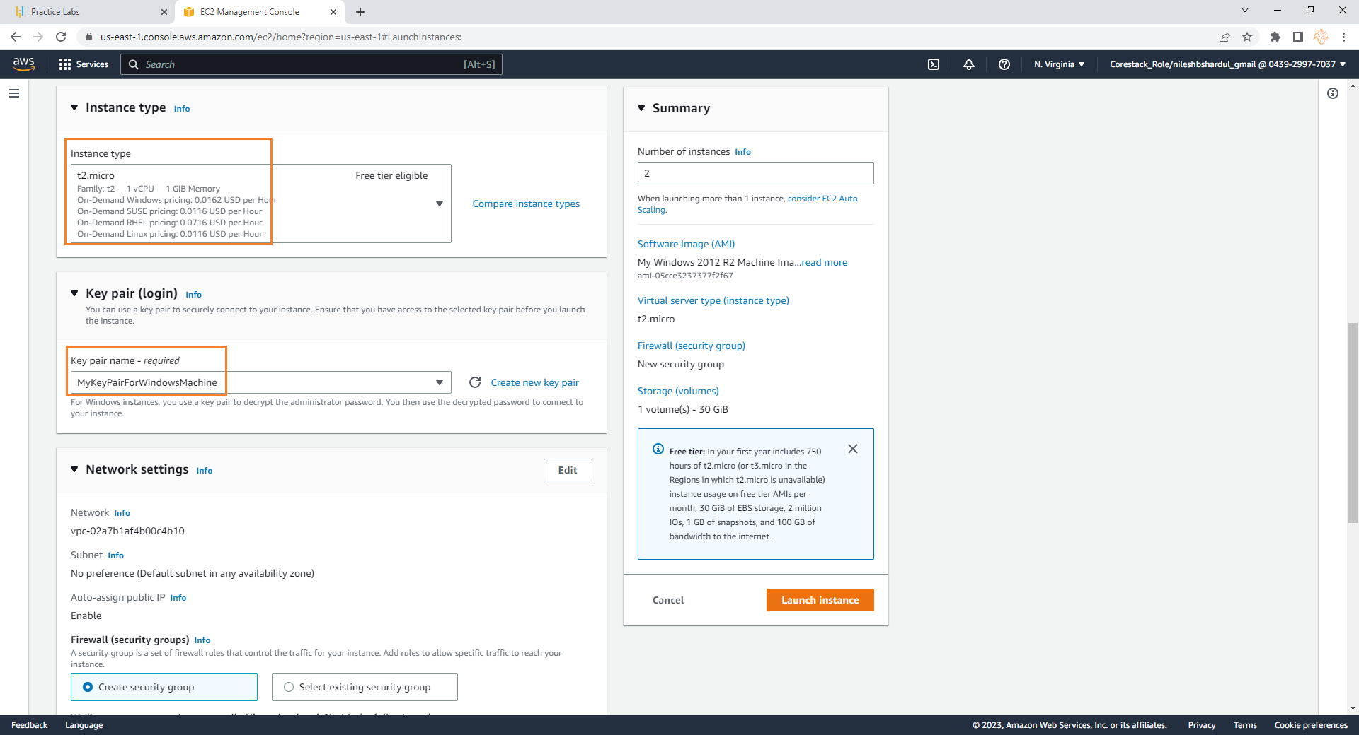
Step 2: Select instance type e.g. t2.micro and Key pair which is downloaded before (here you can create new Key pair if required)

Slide 47
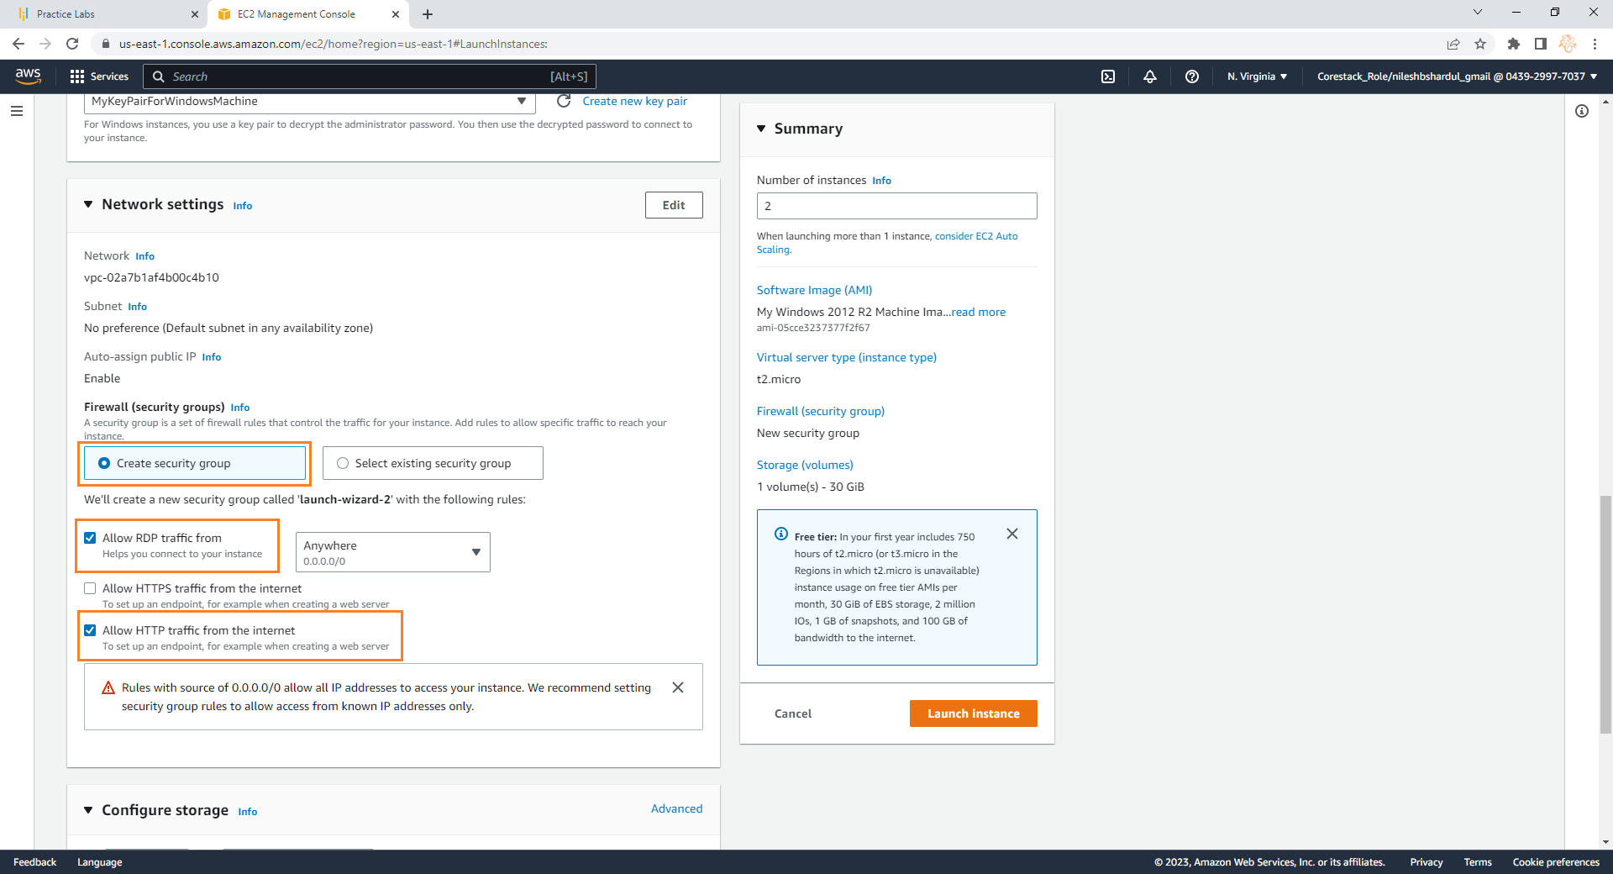
Step 3: Select Create security group and following 2 options below- 1. Allow RDP traffic from 2. Allow HTTP traffic from the internet Now click on Launch Instance

Slide 48
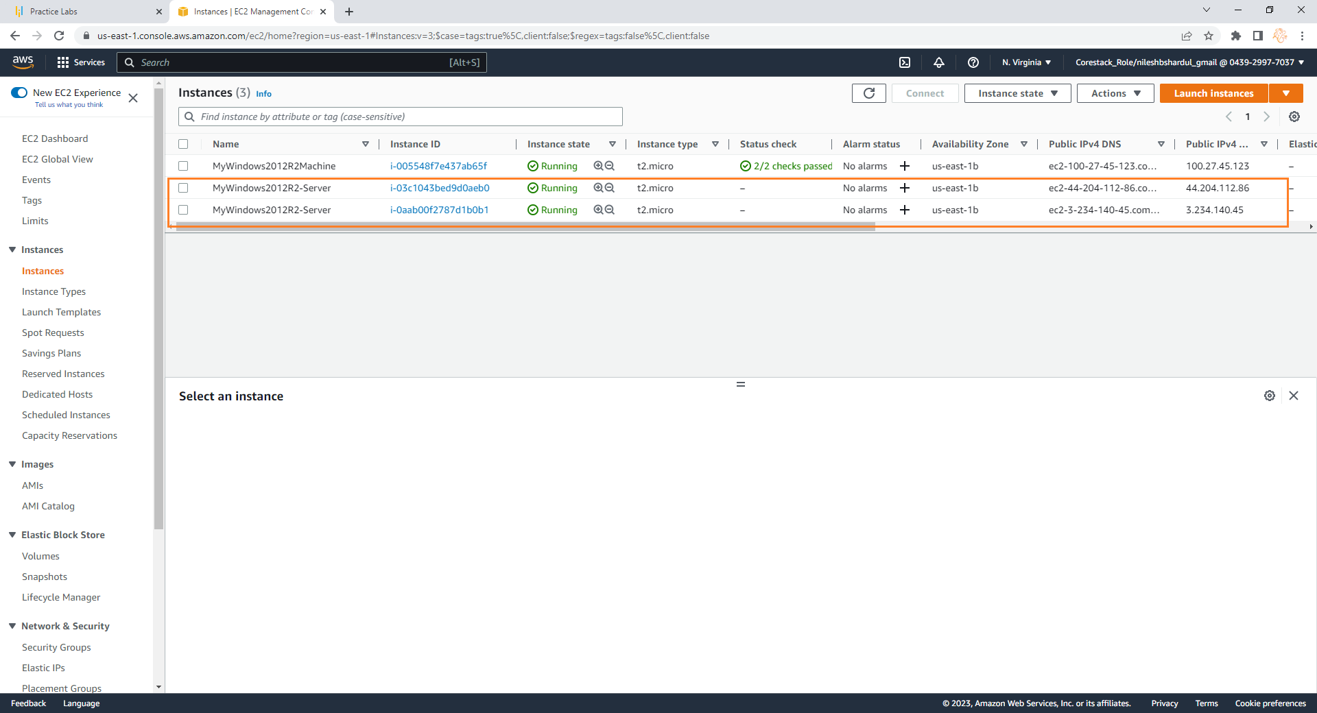
Step 4: You can see 2 new instances running in EC2 > instances as shown below

Slide 49
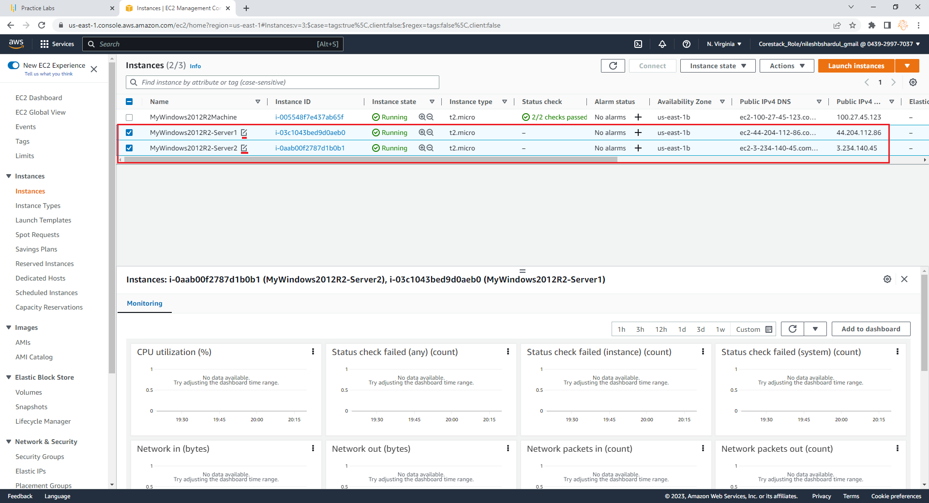
Step 5: Rename the instance names by clicking edit icon as shown below e.g. MyWindows2012R2-server1, MyWindows2012R2-server2

Slide 50
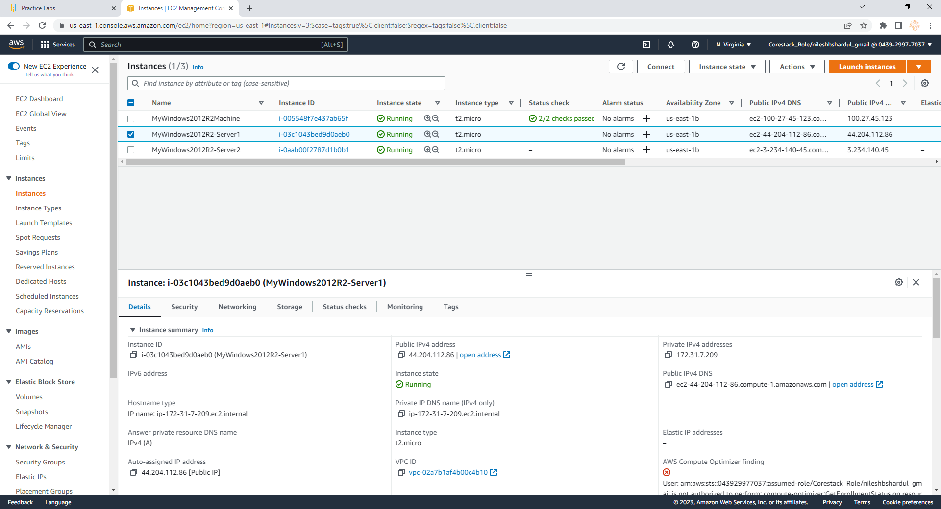
Step 6: Select MyWindows2012R2-server1. Copy Public IP, open new browser, put this IP address in address bar and hit enter.

Slide 51
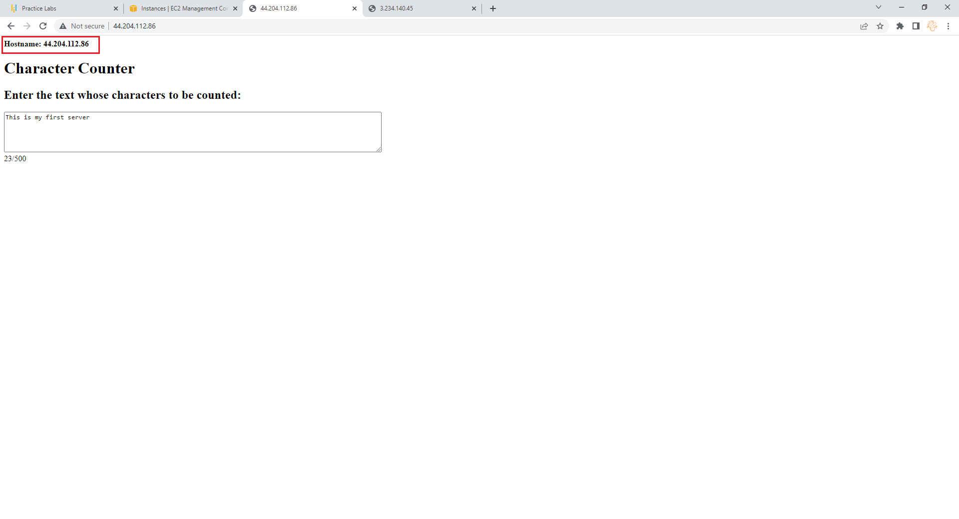
Step 7: You can verify your web application is running on MyWindows2012R2-server1 by checking hostname shown on the top of web page

Slide 52
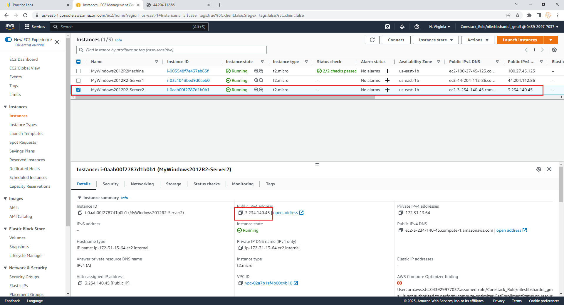
Step 8: Select MyWindows2012R2-server2. Copy Public IP, open new browser, put this IP address in address bar and hit enter.

Slide 53
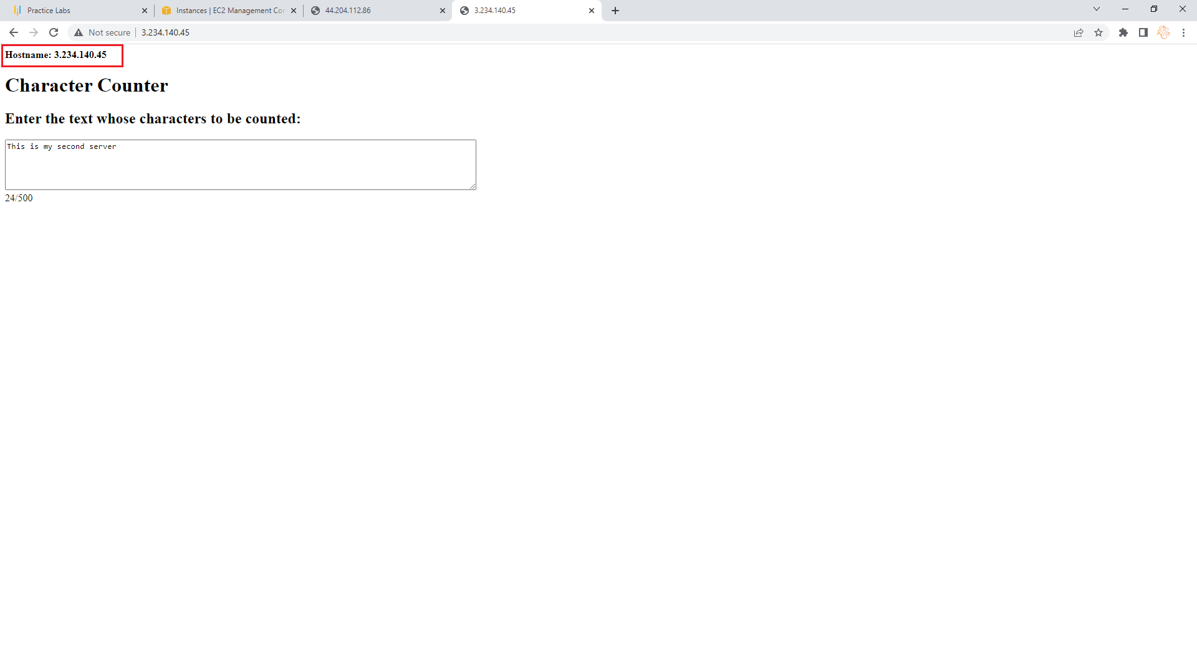
Step 9:You can verify your web application is running on MyWindows2012R2-server2 by checking hostname shown on the top of web page

Slide 54
Create a Load Balancer and attach the instances you have done before
Note: All configuration selected as per free tier available

Slide 55
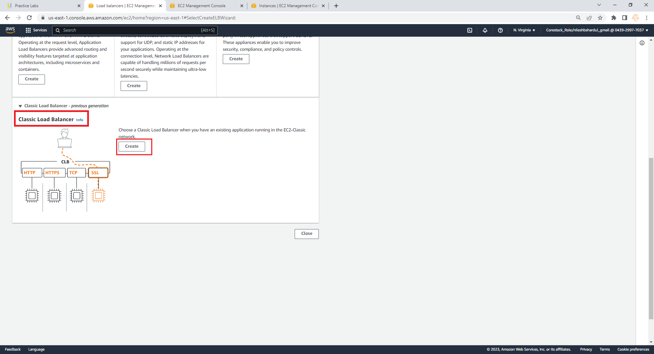
Step 1: Go to Load balancer from EC2 service left menu, select Classic Load Balancer and click on create

Slide 56
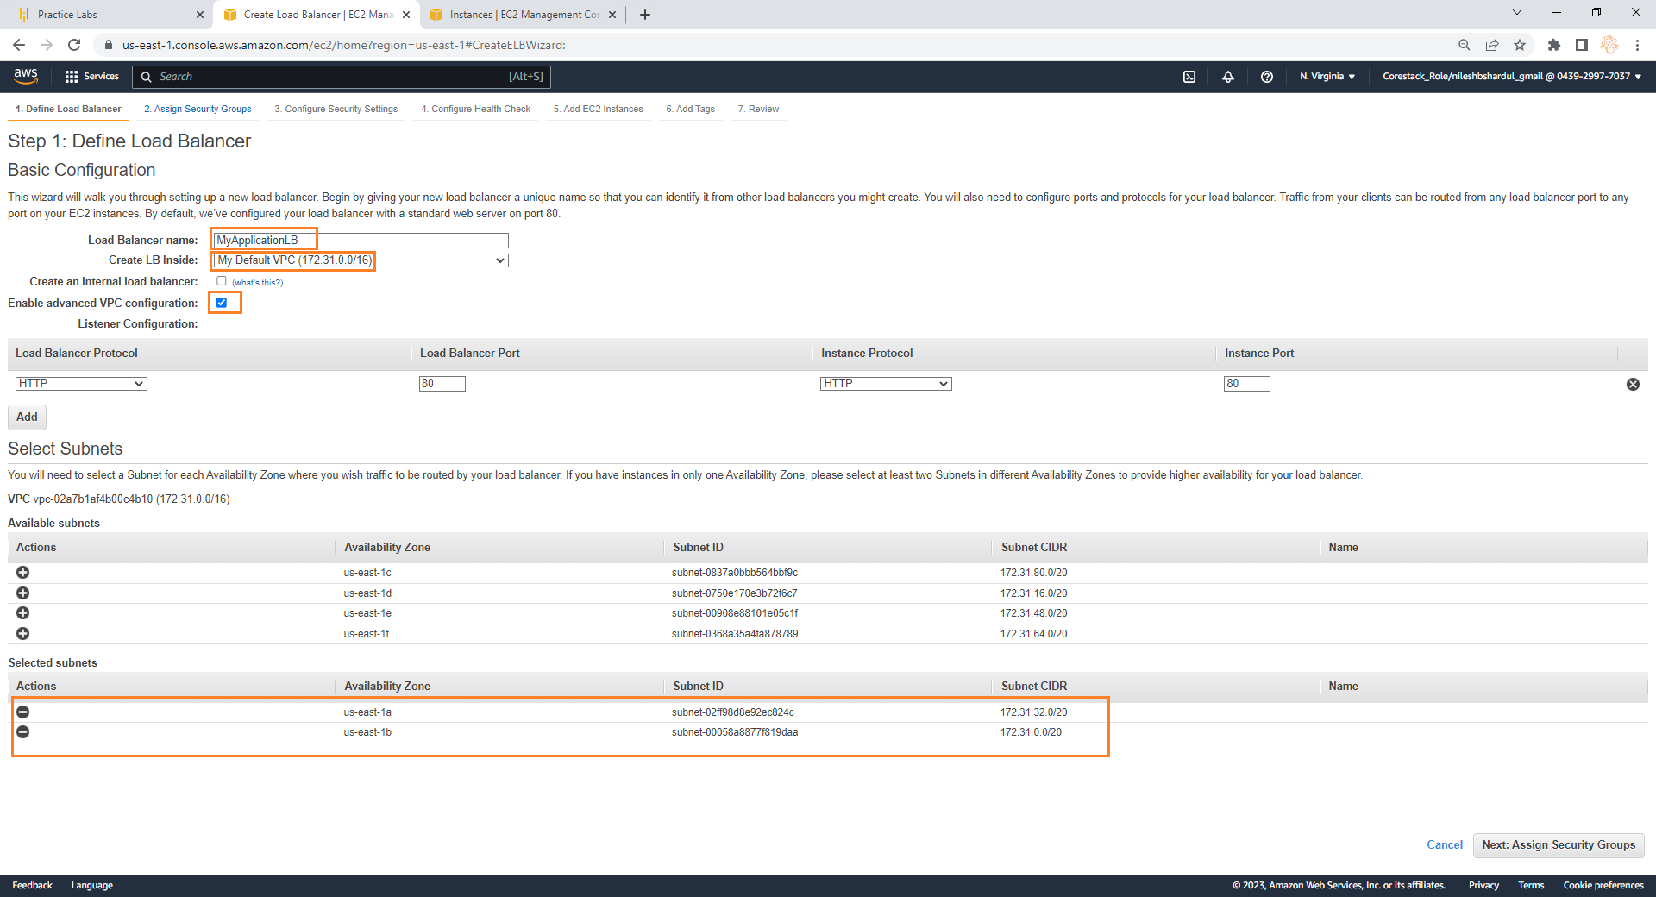
Step 2: Give name to load balancer e.g. MyApplicationLB, select your VPC (or default) in Create LB inside and select Enable advanced VPC configuration. Now in the below part you will see the Available subnets of selected VPC and you need to select at least 2 subnets where the load balancer will be created

Slide 57
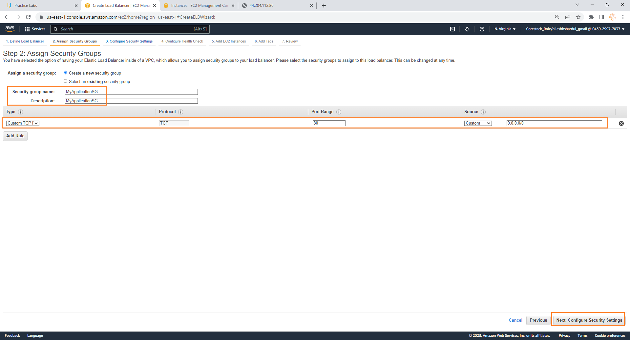
Step 3: Select option Create a new security group (you can select existing if you require). Give Security group name e.g. MyApplicationSG. Keep Custom TCP entry for port 80 below and click on Configure Security Settings button below

Slide 58
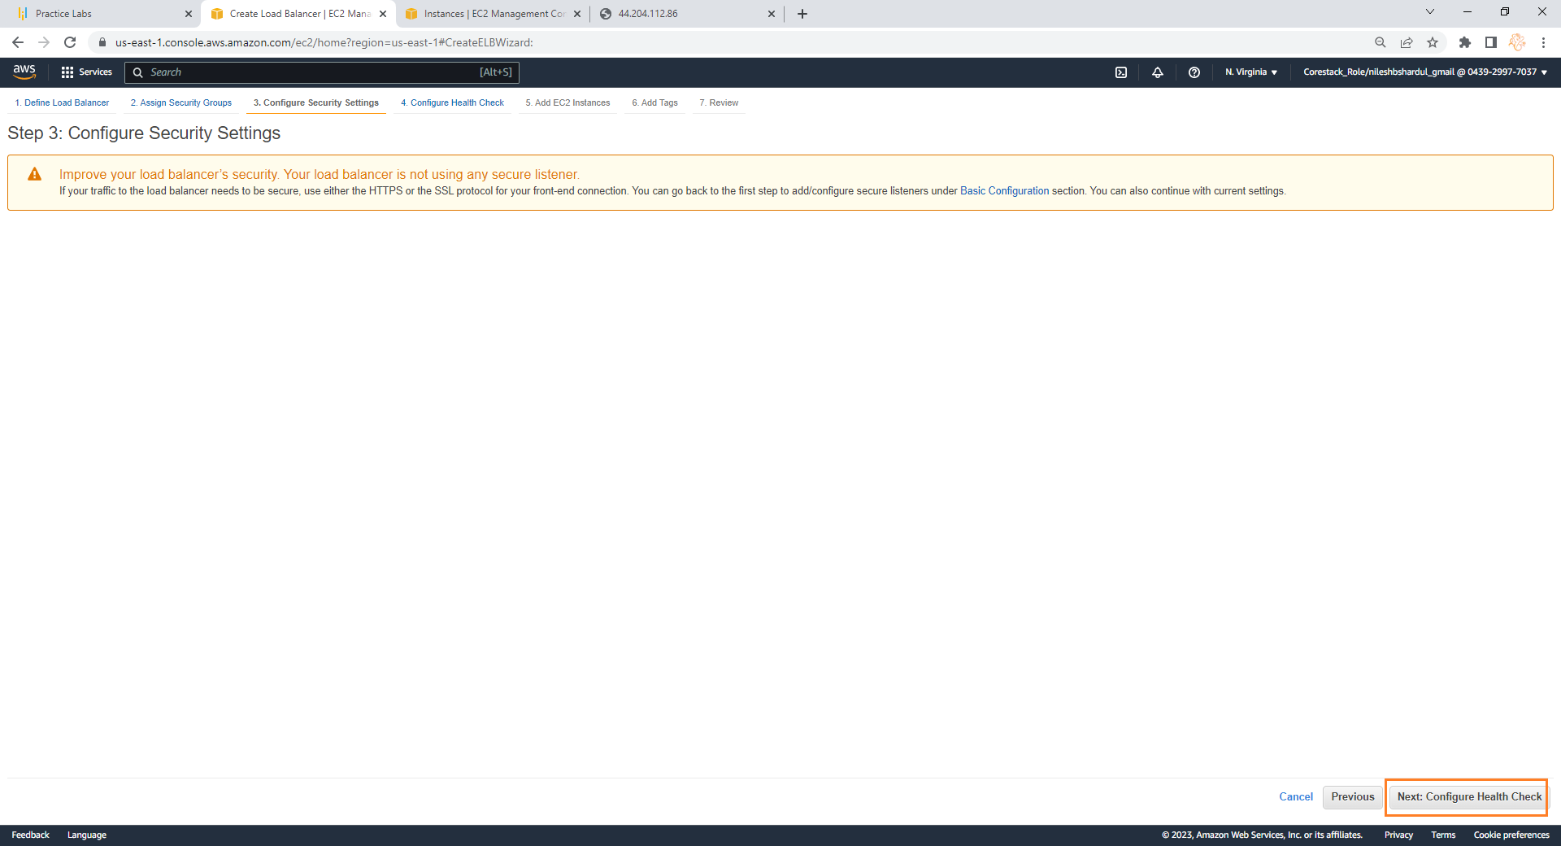
Step 4: Click on Configure Health Check button

Slide 59

Step 5: Keep the default settings (you can customize if you want) and click on Add EC2 instance button

Slide 60

Step 6: Now select EC2 instances for load balancer and select below settings 1. Enable Cross-Zone Load Balancing 2. Enable Connection Draining

Slide 61

Step 7: Add Tags if you want and click on Review and Create button

Slide 62

Step 8: Click on Create button in Review screen

Slide 63
Check the DNS name on the browser
Note: All configuration selected as per free tier available

Slide 64

Step 1: Go to EC Load balancers list and copy DNS name of the new Load balancer created

Slide 65

Step 2: Open new browser, put DNS name in address bar and hit enter. You will see the DNS name as the Hostname on the top of web page. But if you want to distinguish the request i.e. which server served the request after load balancer you need to do small change in the index.html file of each server where it will show you the server name on top of the web page

Slide 66

Step 3: To show the server name, write server name in index.html file (in <h3> tag below <body> tag)as shown below for MyWindows2012R2-Server1 instance

Slide 67

Step 4: Now check DNS name on browser again. Few request will show server name MyWindows2012R2-Server1 on the top as shown below

Slide 68

Step 5: Repeat step3 for MyWindows2012R2-Server2

Slide 69

Step 6:Now check DNS name on browser again. Few request will show server name MyWindows2012R2-Server2 on the top as shown below. So after every refresh on browser you will see the request either will go to MyWindows2012R2-Server1 or MyWindows2012R2-Server2 due to functioning of load balancer

Slide 70
THANK YOU !

